Slide 1
Recent results from MICE and opportunities presented by nuSTORM

Slide 2
The potential of muon beams, pros and cons
Muon beams have the potential to:
  Revolutionise the study of the neutrino
  Provide a route to multi-TeV lepton-antilepton annihilation
Unique potential arises because:
  Heavy: 200 m_{e} < m_{μ} < 0.1 m_{p}
    Enormous (5 × 10⁻¹⁰ cf e) reduction in beam-/bremsstrahlung
    Enhanced (5 × 10⁴ cf e⁺e⁻) s-channel coupling to Higgs
  Decay: lifetime at rest 2.2 μs
    ν_{e}, ν_{μ} – 50/50
    Precisely known energy spectrum
Challenges:
  Tertiary beam
  Decay: lifetime at rest 2.2 μs

Slide 3
Neutrino Factory: sensitivity & precision
Unique:
  Large, high-energy
  ν_{e} (ν_{e}) flux
    Muon-beam cooling
  Favourable rigidity:
    Optimise E for given L

Slide 4
Contents
Motivation
Recent results from MICE
nuSTORM
Conclusions

Slide 5
Recent results from MICE
Recent results from MICE and opportunities presented by nuSTORM

Slide 6

The principle of ionization cooling
Competition between:
  dE/dx [cooling]
  MCS [heating]
Optimum:
  Low Z, large X₀
  Tight focus
  H₂ gives best performance,
  lithium hydride good too

Slide 7
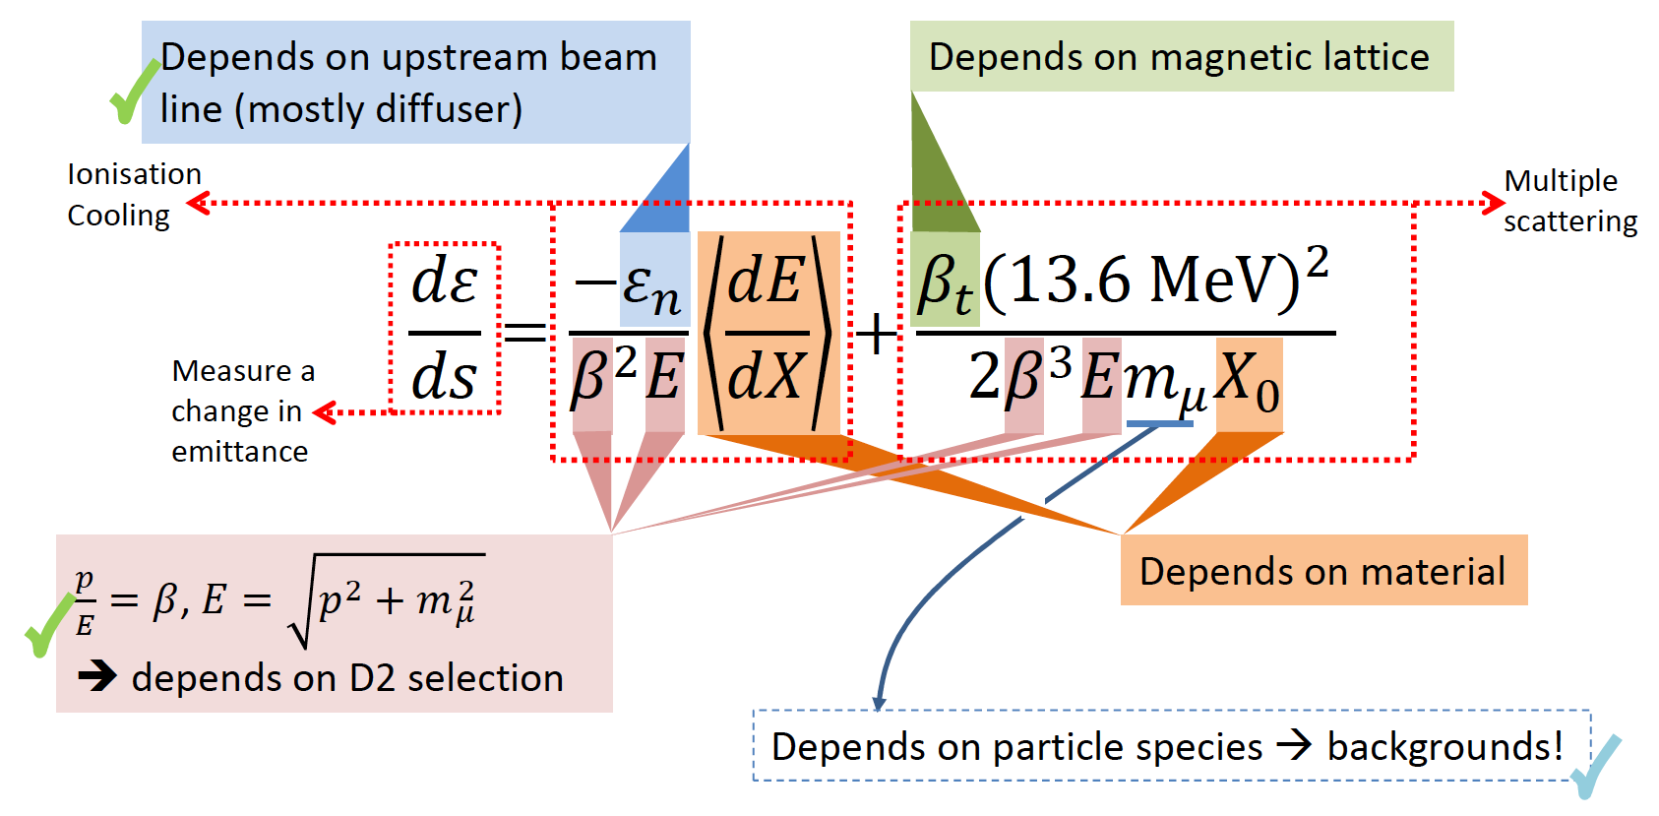
Characterisation of the cooling equation
Acceleration not required (Step IV):
Emittance:
  Vary beam optics/diffuser;
Material:
  Absorber change (LH2; LiH);
p, E and β:
  Vary beam momentum, optics

Slide 8
Measurement of muon-LiH scattering

Slide 9
Emittance reconstruction
Construct phase-space covariance matrix:
  One track at a time
Compute normalised transverse emittance

Slide 10
Emittance reconstruction
Reconstruction of emittance “particle-by-particle” in upstream tracker
  200 MeV/c muon beam; 4T in upstream solenoid only, first ~2 hours of data taking
Validates MICE measurement approach

Slide 11
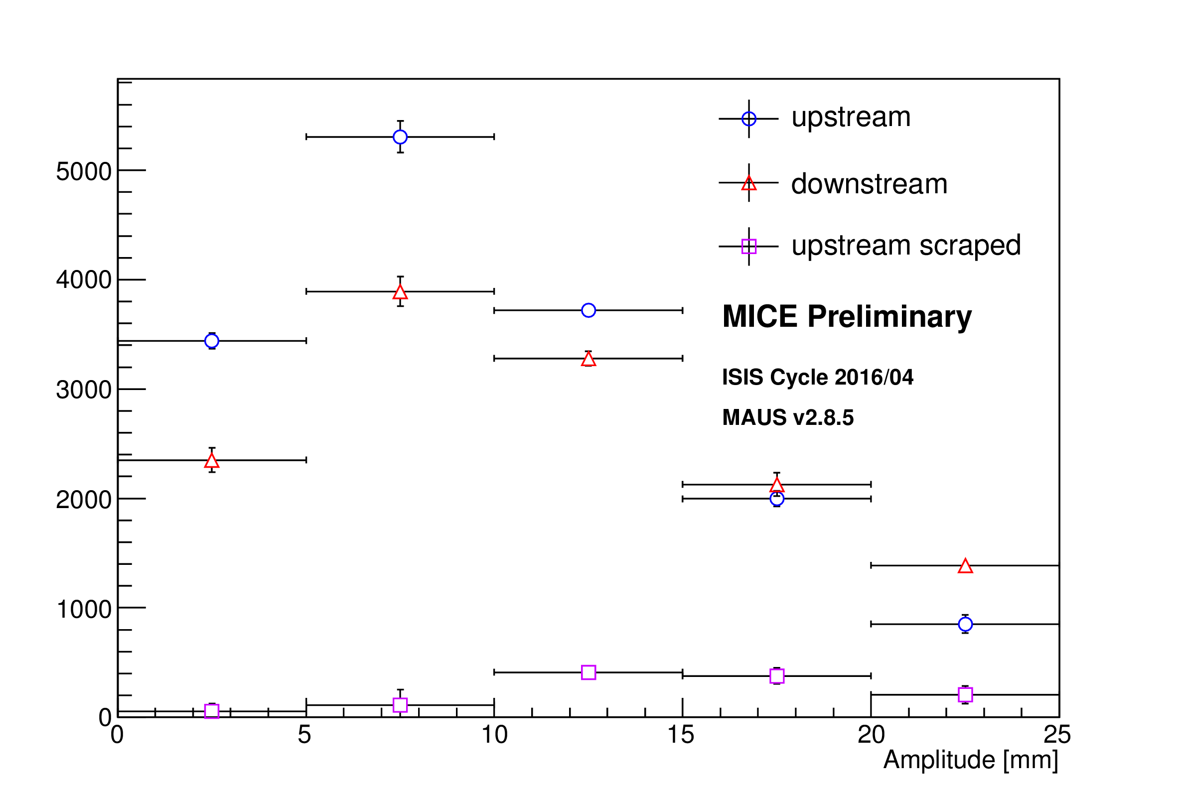
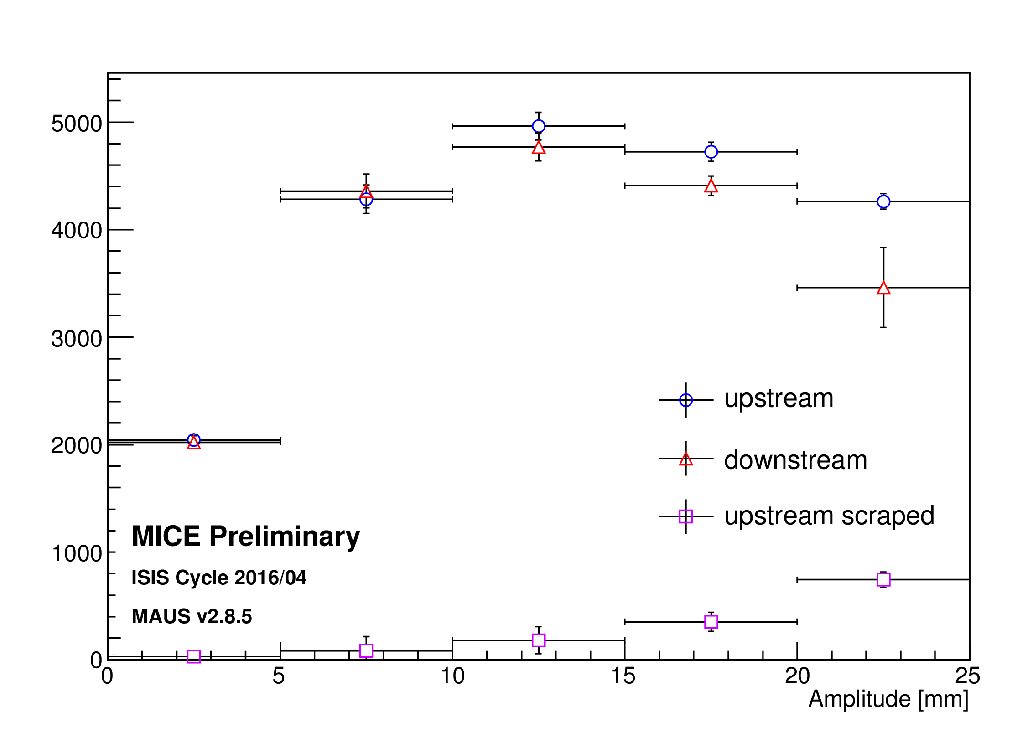
Particle “amplitude”
Amplitude:
  Area of ellipse similar to beam ellipse the surface of which passes through phase-space coordinates of test particle
Increase in population at low amplitude would be a signal of ionization cooling
140 MeV/c; 10 mm
in preparation …
… stay tuned!
140 MeV/c; 6 mm
140 MeV/c; 3 mm

Slide 12
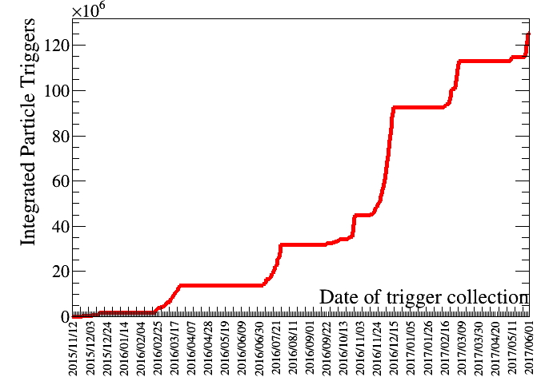
Cooling with liquid hydrogen
Full pass through LiH data taking complete
LH₂ system installed and commissioned with Ne
  Final safety tour later today!
Data taking with LH2 absorber autumn 2017
Exciting publications in preparation and to come!

Slide 13
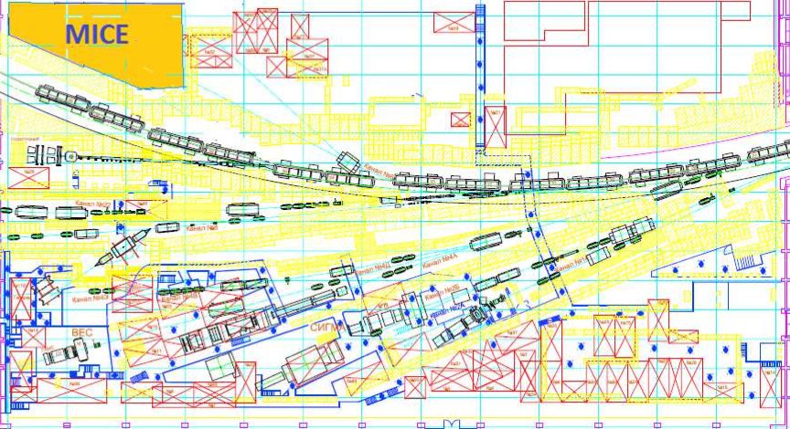
Full demonstration of ionization cooling
To ”prototype” Ionization cooling requires acceleration (RF):
  Upgrade to present MICE set-up
  Outside approved programme
Opportunity to implement MICE “demonstration lattice” at IHEP Protvino:
  Early stages in discussions

Slide 14
nuSTORM
Recent results from MICE and opportunities presented by nuSTORM

Slide 15
Neutrinos from stored muons
Scientific objectives:
  %-level (ν_{e}N)cross sections
    Double differential
  Sterile neutrino search
    Beyond Fermilab SBN
Precise neutrino flux:
  Normalisation: < 1%
  Energy (and flavour) precise
π ➔ μ injection pass:
  “Flash” of muon neutrinos

Slide 16
Neutrino flux
10.1146/annurev-nucl-102014-021930
ν_{μ} flash:
  Pion: 6.3 × 10¹⁶ m⁻² at 50m
  Kaon: 3.8 × 10¹⁴ m⁻² at 50m
    Well separated from pion neutrinos
ν_{e} and ν_{μ} from muon decay:
  ~10 times as many ν_{e} as, e.g. J-PARC beam
  Flavour composition, energy spectrum
    Use for energy calibration

Slide 17
Search for CPiV in lbl oscillations
Seek to measure asymmetry:
  P(ν_{μ}➤ν_{e}) – P(ν_{μ}➤ν_{e})
Event rates convolution of:
  Flux, cross sections, detector mass, efficiency, E-scale
    Measurements at %-level required
Lack of knowledge of cross-sections leads to:
  Systematic uncertainties; and
  Biases; pernicious if ν and ν differ

Slide 18
Systematic uncertainty and/or bias
Phys.Rev. D89 (2014) no.7, 073015; Coloma et al
Uncertainty
(cross section
and ratio)
Event mis-classification
Phys.Rev. D92 (2015) no.9, 091301; Ankowski et al
Energy scale mis-calibration
Missing energy (neutrons)

Slide 19
Systematic uncertainties
Morfin

Slide 20
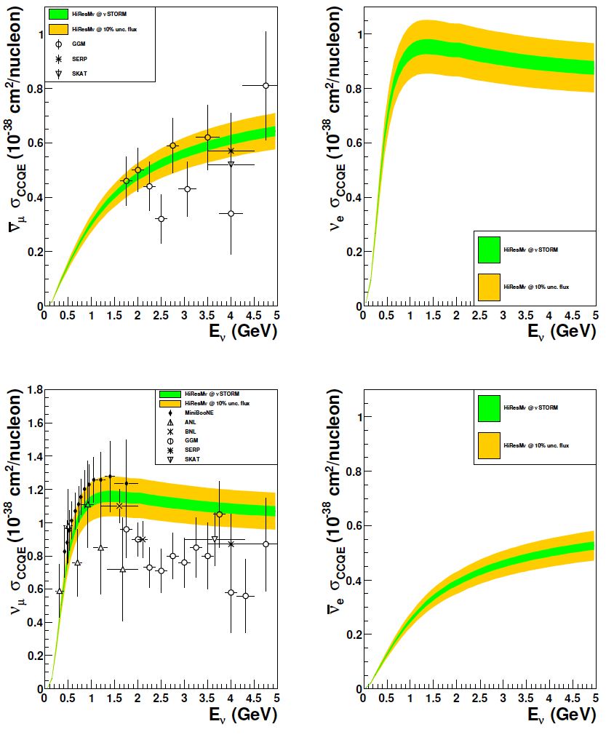
CCQE measurement at nuSTORM
CCQE at nuSTORM:
  Six-fold improvement in systematic uncertainty compared with “state of the art”
  Electron-neutrino cross section measurement unique
Require to demonstrate:
  ~<1% precision on flux
Individual ν_{e} measurements from T2K and MINERvA
[10.1103/PhysRevLett.113.241803, 10.1103/PhysRevLett.116.081802 ]
10.1103/PhysRevD.89.071301; arXiv:1305.1419

Slide 21
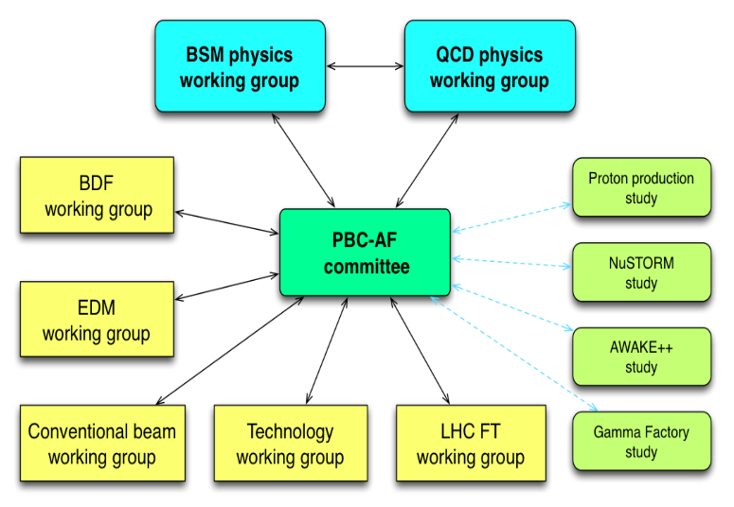
Physics Beyond Colliders study group
http://pbc.web.cern.ch

Slide 22
Elements of study
Physics case:
  Neutrino-scattering for:
    Oscillation
    Nuclear
    “BSM”
Specification:
  Energy range:
    Long- and short-baseline neutrino
    Nuclear and particle physics
  Acceptance:
    Rate
    Neutrino-energy calibration
Accelerator:
  Full simulation that demonstrates <~1% flux precision
  Energy range (i.e. sweep down from max)
Implementation:
  Feasibility study for implementation at CERN
Detector:
  Others are “on this”, so:
    Adopt performance of typical, or assumed, detector

Slide 23
Conclusions
Recent results from MICE and opportunities presented by nuSTORM

Slide 24
Conclusions
Muon accelerators could:
revolutionise neutrino physics & provide multi-TeV lepton-anti-lepton collisions
MICE:
  LiH μ-scattering progrm underway
  First study of phase-space density evolution using a LiH absorber in line with expectations:
    Results for beams where a cooling signal is expected are in preparation
  LH₂ absorber commissioned w\ Ne
  Data taking with LH₂ to start Sep17
  More exciting results on the way!
nuSTORM can deliver:
  νN scattering measurements to:
    Serve the long- and short-baseline neutrino programmes
    Provide a valuable probe for nuclear physics
CERN PBC study:
  Opportunity to:
    Demonstrate “physics need”;
    Establish feasibility at CERN

