Slide 1
Introduction to Neutrino Physics Session
A.K.Ichikawa, Kyoto university
(working on the T2K experiment. Experimentalist!)

Slide 2
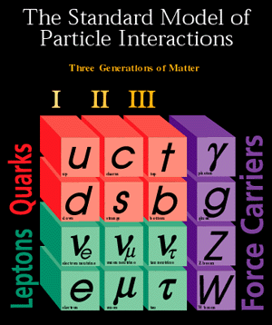
Constituents of This World
How can we distinguish btw.
u, c and t
d, s and b
ν_{e}, ν_{μ} and ν_{τ}
e, μ and τ
Same spin, same charge…
Only by mass! Except for ν’s.
Electric charge
+α (Higgs, dark matter, dark energy…..?)
Fig. from FNAL home page

Slide 3
How can we distinguish neutrinos?
Neutrinos do interact with matter and
$$μ$$
$$τ$$
$$e$$
$$ν_{μ}$$
$$ν_{τ}$$
$$ν_{e}$$
An electron neutrino changes to an electron.
A muon neutrino changes to a muon.
A tau neutrino changes to a tau.
We call this categorization ‘flavor’.

Slide 4
Mixing btw. Flavor and Mass
We know that there are three types of charged lepton ($e,μ,τ$), distinguishable only via mass.
Then, we found that there are three types of neutrinos, distinguishable via interaction w/ matter.
IF NEUTRINOS HAVE MASSES, there is no reason for three types to be mass eigenstates.
$\left|\left.ν_{e}\right\rangle =a\right|\left.ν_{1}\right\rangle +b\left|\left.ν_{2}\right\rangle +c\right|\left.ν_{3}\right\rangle ,$ ν₁,ν₂,ν₃ : mass eigenstates
Same thing is happening for quarks.
Partner of $\left|\left.up\right\rangle \text{quark}=a\right|\left.down\right\rangle +b\left|\left.strange\right\rangle +c\right|\left.bottom\right\rangle$

Slide 5
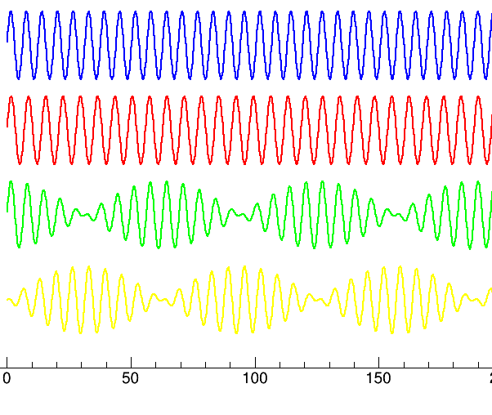
A neutrino is produced as an eigenstate of one flavor, but propagate with two different speed
ν₁
Traveling distance L
ν₂
|ν_{α}>
(α=e,μ,τ)
→ $|ν_{β}>$
muon neutrino
tau neutrino
Neutrino Oscillation!
flight length

Slide 6
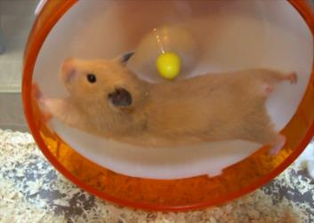
Quark vs. Neutrino – Oscillation-
time evolution of mass eigenstate:$m_{i}$
$e^{−i\left(Et−px\right)}$
quark
“rest flame” approximation
$$e^{−i\left(Et−px\right)}≅e^{−im_{i}t}$$
modulation frequency = $∆m$
$⇒$ O(nano~pico-sec.)
neutrino
ultra-relativistic approximation
$$e^{−i\left(Et−px\right)}≅e^{−i\left\{EL−\left(E−\frac{m_{i}^{2}}{2E^{}}\right)L\right\}}= e^{−i\frac{m_{i}^{2}}{2E}L}$$
modulation frequency = $∆m^{2}$
$⟹$ O(mili-scond)$\sim$O(100km)

Slide 7
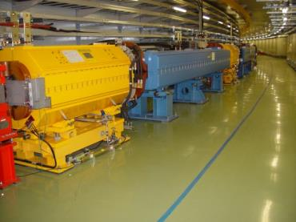
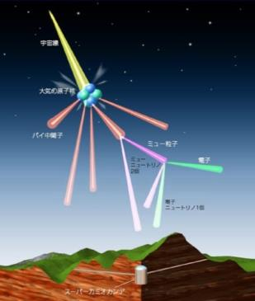
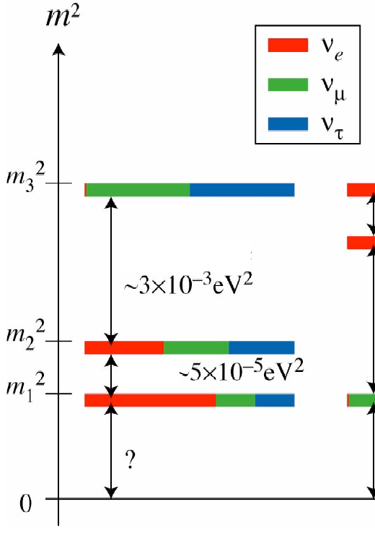
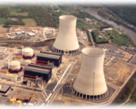
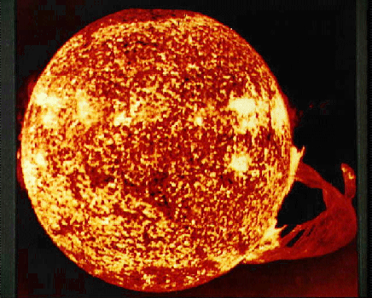
Oscillate across loooong distance
$$P\left(ν_{α}→ν_{β}\right)=\sin{{}_{}^{2}{2θ}\left(1.27Δm^{2}\left({e\text{V}}^{2}\right)\frac{L\left(\text{km}\right)}{E\left(GeV\right)}\right)}$$
Atmospheric
Accelerator
~300 km @ Eν=700 MeV
Reactor
~2.4x10⁻³eV²
~7.6x10⁻⁵eV²
~50 km @ Eν=3 MeV
Solar
However, in other words, nature allows oscillations corresponding to three Δm²’s happen in Earth Scale
$m_{3}^{2}≫m_{2}^{2}>m_{1}^{2}$ case
$m_{2}^{2}{>m}_{1}^{2}>m_{3}^{2}$ could be also possible

Slide 8
Appearance vs. Disappearance
Why disappear?
How is the neutrino flavor identified?
Neutrino flavor is tagged via charged current (CC) interaction.
threshold energy
$ν_{e}+n→e^{−}+p$ 0 MeV for ν_{e}
$ν_{μ}+n→μ^{−}+p$ 110 MeV for ν_{μ}
$ν_{τ}+n→τ^{−}+p$ 3.5 GeV for ν_{τ}
At Eν < Ethreshold,
that flavor is not observed and recognized as disappearance.

Slide 9
Mixing matrix by Neutrino oscillations
$$\left(\begin{matrix}{\text{flavor}}_{1} \\ {\text{flavor}}_{2} \\ {\text{flavor}}_{3}\end{matrix}\right)=U_{3×3}\left(\begin{matrix}m_{1} \\ m_{2} \\ m_{3}\end{matrix}\right)$$
CKM matrix for quarks
PMNS matrix for leptons
$$\left(c_{ij}=\cos{θ_{ij}},s_{ij}=\sin{θ_{ij}}\right)$$
$$U_{PMNS}=\left(\begin{matrix}1 & 0 & 0 \\ 0 & +c_{23} & +s_{23} \\ 0 & −s_{23} & +c_{23}\end{matrix}\right)\left(\begin{matrix}+c_{13} & 0 & +s_{13}e^{−iδ} \\ 0 & 1 & 0 \\ −s_{13}e^{iδ} & 0 & +c_{13}\end{matrix}\right)\left(\begin{matrix}+c_{12} & +s_{12} & 0 \\ −s_{12} & +c_{12} & 0 \\ 0 & 0 & 1\end{matrix}\right)$$
$θ_{13,} \left|Δm_{32}^{2}\right|$(,MO)
$$θ_{12,}Δm_{21}^{2}$$
$$θ_{23,}\left|Δm_{32}^{2}\right|$$
$θ_{13,}δ_{CP}$(, MO)
Atmospheric
Solar
Accelerator
Reactor

Slide 10
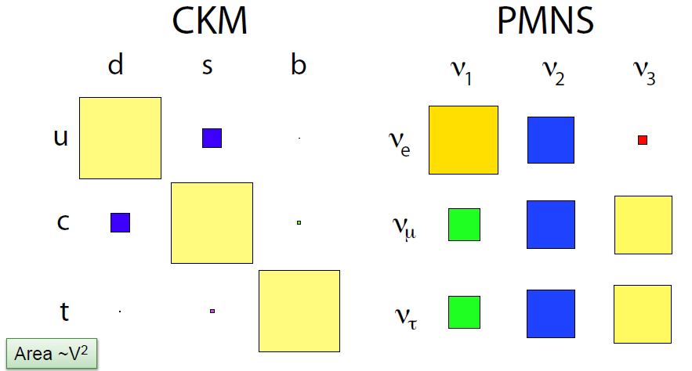
And we found
$$\left(\begin{matrix}{\text{flavor}}_{1} \\ {\text{flavor}}_{2} \\ {\text{flavor}}_{3}\end{matrix}\right)=U_{3×3}\left(\begin{matrix}m_{1} \\ m_{2} \\ m_{3}\end{matrix}\right)$$
S. Stone, ICHEP2012

Slide 11
Do they mean something?
$$\left(\begin{matrix}{\text{flavor}}_{1} \\ {\text{flavor}}_{2} \\ {\text{flavor}}_{3}\end{matrix}\right)=U_{3×3}\left(\begin{matrix}m_{1} \\ m_{2} \\ m_{3}\end{matrix}\right)$$
quark
lepton
$$U_{CKM}≈\left(\begin{matrix}0.97 & 0.22 & 0.004 \\ 0.22 & 1.0 & 0.04 \\ 0.008 & 0.04 & 1.0\end{matrix}\right)$$
$$U_{PMNS}≈\left(\begin{matrix}0.82 & 0.55 & 0.14 \\ −0.47 & 0.53 & 0.71 \\ 0.31 & −0.65 & 0.69\end{matrix}\right)$$
Assuming some symmetry among quarks and leptons, some models predict
Notes:
要確認

Slide 12
CP violation by three generation mixing
Mixing with > 3 generation can have imaginary components,
which introduce different behavior between particle and anti-particle=CP violation.
In case of 3 generations, one CP phase.
$$\left(c_{ij}=\cos{θ_{ij}},s_{ij}=\sin{θ_{ij}}\right)$$
$$U_{PMNS}=\left(\begin{matrix}1 & 0 & 0 \\ 0 & +c_{23} & +s_{23} \\ 0 & −s_{23} & +c_{23}\end{matrix}\right)\left(\begin{matrix}+c_{13} & 0 & +s_{13}e^{−iδ} \\ 0 & 1 & 0 \\ −s_{13}e^{iδ} & 0 & +c_{13}\end{matrix}\right)\left(\begin{matrix}+c_{12} & +s_{12} & 0 \\ −s_{12} & +c_{12} & 0 \\ 0 & 0 & 1\end{matrix}\right)$$
CKM (quark sector) δ~60°
PMNS (lepton sector) δ~?
$δ_{CP}^{CKM}\sim 60°\sim 70°$ looks large, but $δ_{CP}$ is dependent on definition.
Jarlskog Invariant : independent of definition. show the size of CP violation effect.
$J_{CP}≡Im\left(U_{μ3}U_{e3}^{∗}U_{e2}U_{μ2}^{∗}\right)=\frac{1}{8}\sin{2θ_{12}}\sin{2θ_{23}}\sin{2θ_{13}}\cos{θ_{13}}\sin{δ_{CP}}$
$$J_{CP}^{CKM}≈3×{10}^{−5}$$
$J_{CP}^{PMNS}≈0.03\sin{δ_{CP}}$ → Can be three orders large!

Slide 13
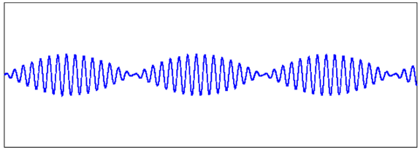
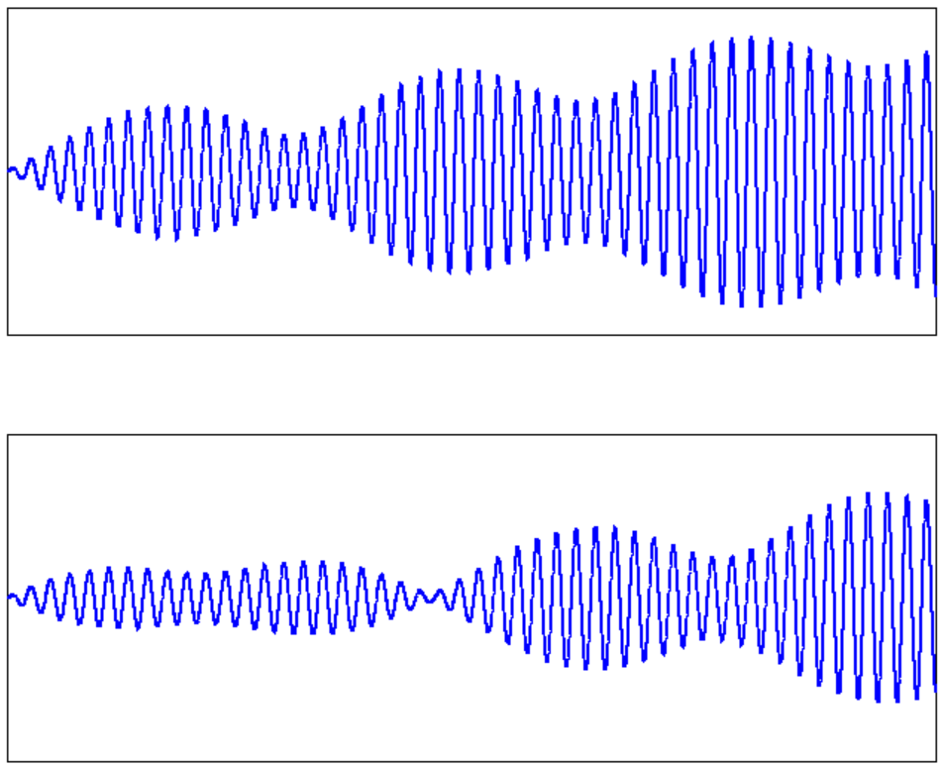
neutrino oscillation of three states
Two neutrinos case
Three neutrinos case
neutrino
Depending on the value of $δ_{CP}$, neutrino and antineutrino oscillate differently!
antineutrino

Slide 14
CP violation in neutrino oscillation
$$ν_{μ}$$
(anti-)$ν_{μ}$ beam from accelerator
CP violation is accessible only via appearance, and can be large for $ν_{e}$ appearance.
ν_{μ} disappearance $∼∝\sin{{}_{}^{2}{2θ_{23}}}\sim 1$00% at right energy
ν_{e}
$\sim ∝\sin{{}_{}^{2}{θ_{23}}}\sin{{}_{}^{2}{2θ_{13}}}$~5%
$ν_{τ}$
$\sim ∝\cos{{}_{}^{4}{θ_{13}}}sin{{}_{}^{2}{2θ_{23}}}$~95%
$$ν$$
$$\overline{ν}$$
$$ν_{e}$$
$$ν_{τ}$$
Interference term
$\sim ∝\sin{δ_{CP}}$ for neutrino
$\sim ∝−sin{δ_{CP}}$ for antineutrino
$±27\%$ effect on $ν_{e}$ appearance

Slide 15
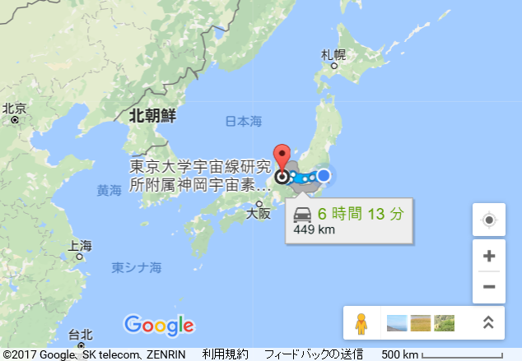
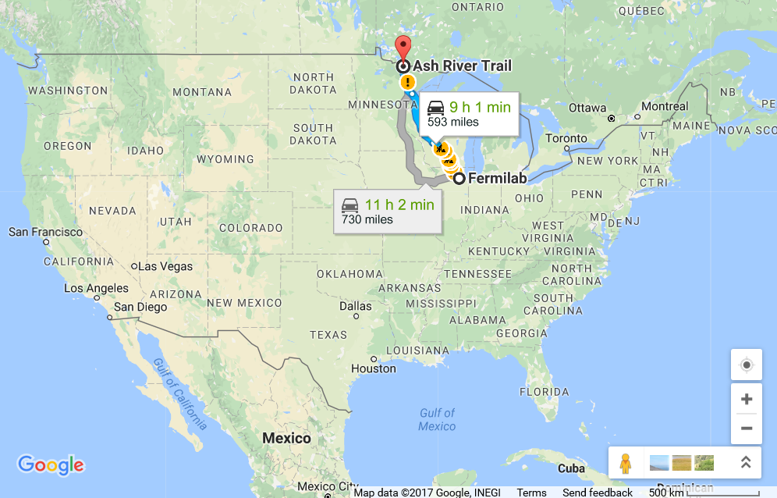
Accelerator-based long baseline experiment – now and future -
New result
T2K: running
Hyper-K : planning, aiming to start ~2026
$L=295$ km, Osc. max. at ~0.6 GeV
Water Cherenkov
J-PARC
NOvA far detector
Super-Kamiokande
DUNE far detector
Fermilab
NOvA : running
$L=819$ km, Osc. max. at ~1.7 GeV
Finely-segmented liquid scintillator
DUNE : aiming to start ~2026
$L=1,300$ km, Osc. max. at ~2.6 GeV
Liquid Ar TPC

Slide 16
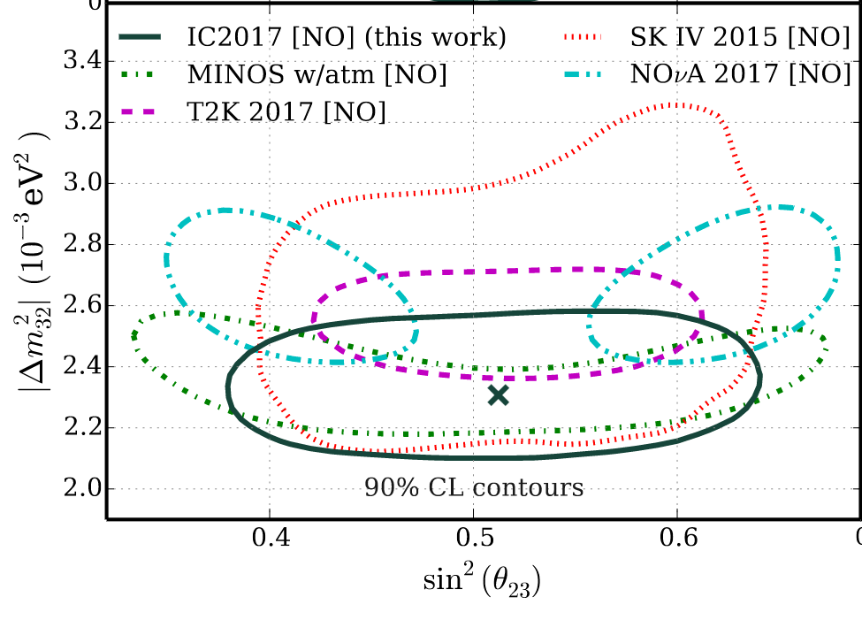
What’s else? known unknowns (1) Is $θ_{23}$ maximal(45$°$)?
$$\left(c_{ij}=\cos{θ_{ij}},s_{ij}=\sin{θ_{ij}}\right)$$
$$U_{PMNS}=\left(\begin{matrix}1 & 0 & 0 \\ 0 & +c_{23} & +s_{23} \\ 0 & −s_{23} & +c_{23}\end{matrix}\right)\left(\begin{matrix}+c_{13} & 0 & +s_{13}e^{−iδ} \\ 0 & 1 & 0 \\ −s_{13}e^{iδ} & 0 & +c_{13}\end{matrix}\right)\left(\begin{matrix}+c_{12} & +s_{12} & 0 \\ −s_{12} & +c_{12} & 0 \\ 0 & 0 & 1\end{matrix}\right)$$
$θ_{12}=33.6°±0.8°$
$θ_{23}=46°±2°$
$θ_{13}=8.3°±0.2°$
Maximal mixing disfavored at 2.6σby NOvA
Phys. Rev. Lett. 118, 151802 (2017)
http://icecube.wisc.edu/news/view/522

Slide 17
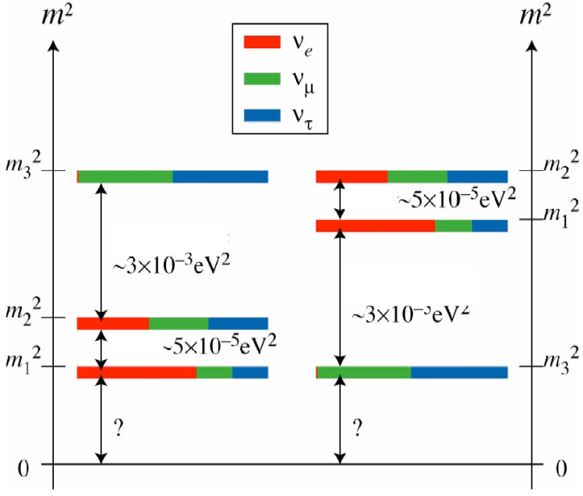
What’s else? known unknowns (2) Mass order
Normal
Inverted
m₂
m₃
~7.6x10⁻⁵eV²
m₁
~2.4x10⁻³eV²
OR
m₂
~2.4x10⁻³eV²
m₁
~7.6x10⁻⁵eV²
m₃
It is very important in connection with the double-beta-decay search.

Slide 18
What’s else? known unknowns (2) Mass order
How can we determine?
Matter effect for (anti-)$ν_{e}$ appearance from (anti-)$ν_{μ}$
In earth, $ν$’s feel potentials by
neutral current ($ν+e→ν+e$) for all $ν$’s → dose not affect oscillation
charged current($ν+e→e+ν$) only for (anti-)$ν_{e}$ → change appearance probability
opposite for $ν$ and anti-$ν$
bigger for longer L (higher E) experiment
(2) two frequencies for disappearance of anti-$ν_{e}$ from reactors
amplitude $P_{31}>P_{32}$
frequency
$P_{31}>P_{32}$ for NO
$P_{31}<P_{32}$ for IO

Slide 19
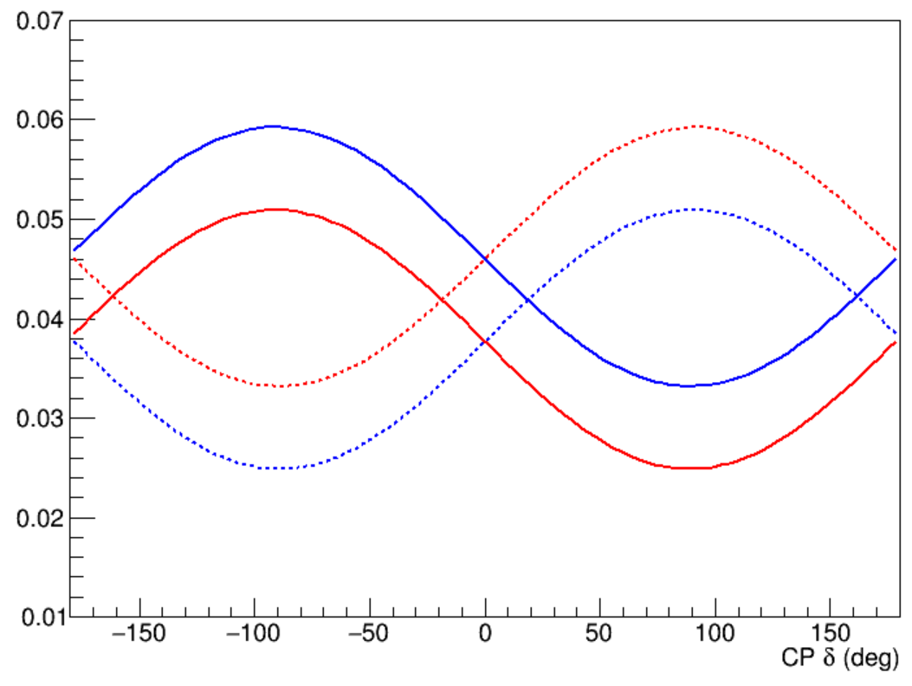
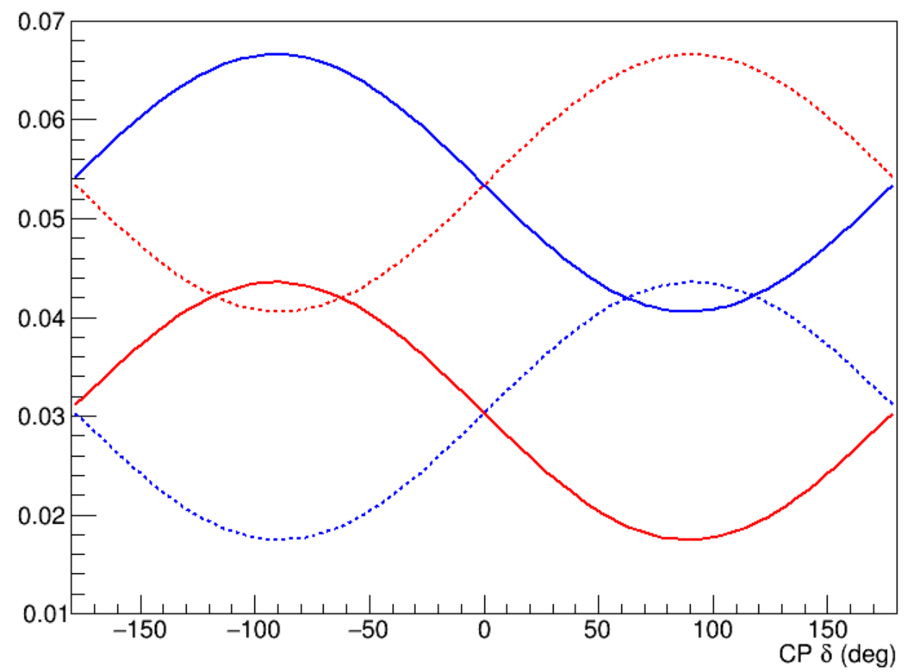
Complementarity of acc. experiments at different baseline length
(anti-)$ν_{e}$ appearance probability
NH
$$ν$$
IH
anti-$ν$
T2K ($L$=295km) NOvA($L$=819 km)
each line has ~10% uncertainty from $θ_{23}$
degeneracy among $θ_{23}$,$δ_{CP}$ and MO can be solved

Slide 20
Complementarity of acc. experiments at different baseline length
(anti-)$ν_{e}$ appearance probability
NH
$$ν$$
IH
anti-$ν$
True point
T2K ($L$=295km) NOvA($L$=819 km)
degeneracy among $θ_{23}$,$δ_{CP}$ and MO can be solved

Slide 21
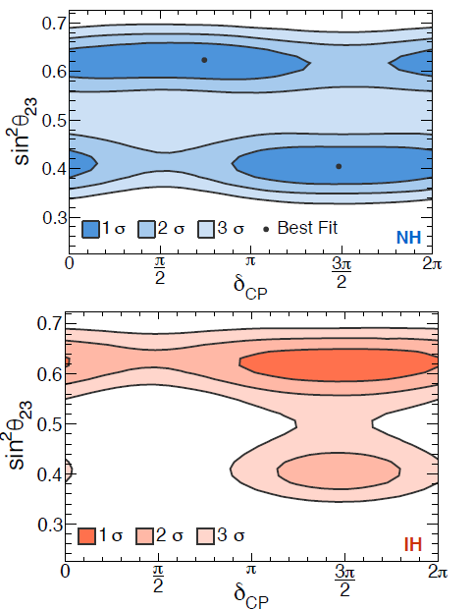
NOvA status
results with neutrino data in 2016.
Observed 33 $ν_{e}$ events on background of 8.2±0.8
Since Feb. 2017, they are accumulating antineutrino data.
Can be very interesting to see $θ_{23}$, mass order, $δ_{CP}$ results

Slide 22
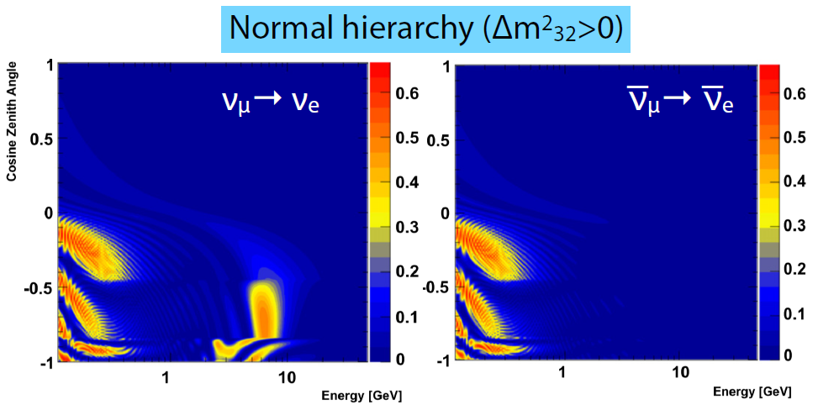
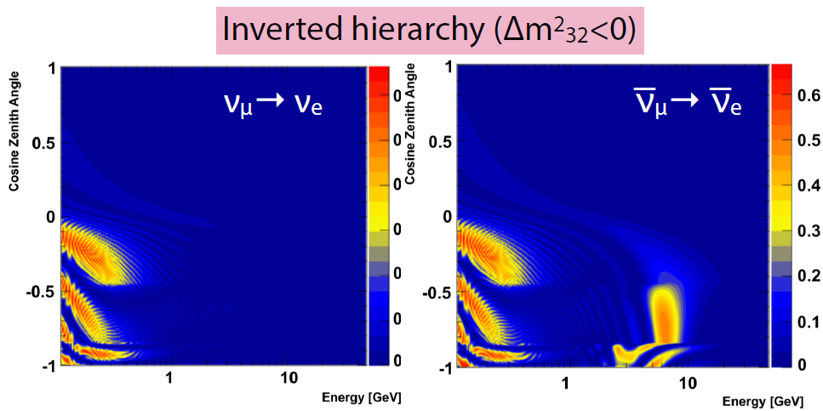
What’s else? known unknowns (2) Mass order
Atmospheric-$ν$ by Super-Kamiokande
Resonance for (anti-)$ν$’s penetrating earth core due to the matter effect.
Obtained $p$-values:
< 3.1% for IH
45% for NH
normal mass ordering???
T2K new result?

Slide 23
What’s else? known unknowns (3) Majorana? and absolute mass
Dirac-type Fermion
$$e^{−}$$
charge conjugation
$$e^{+}$$
$$ν$$
charge conjugation
$$\overline{ν}$$
Majorana-type Fermion
$$ν$$
charge conjugation
$$ν$$
Neutrino is the only known particle which can be Majorana-type Fermion.
Is neutrino Majorana?

Slide 24
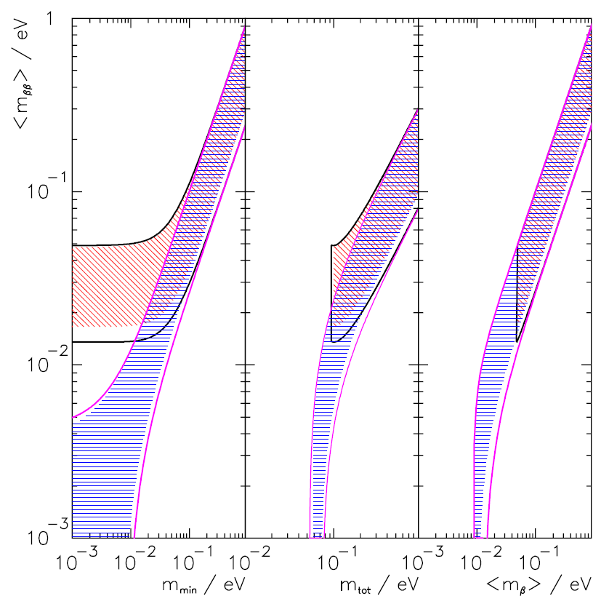
What’s else? known unknowns (3) Majorana? and absolute mass
neutrino-less double-beta ($0νββ$) decay
Bands by $ν$ oscillation and Mjorana phase
Inverted MO
Normal MO
$${}_{}^{A}Z$$
$$e^{−}$$
$${}_{}^{A}{(Z+2)}$$
$$n$$
$$p$$
$$ν=\overline{ν}$$
$$n$$
$$p$$
double beta-decay
$$e^{−}$$
Happens only if neutrino has Majorana-type mass.
Life time $∝ m_{ββ}^{−2}$,
$m_{ββ}≡m_{1}U_{e1}^{2}+m_{2}U_{e2}^{2}$+$m_{3}U_{e3}^{2}$
→ can determine absolute mass
limit by Cosmology
0.23 eV(95%C.L.)
limit by
$β$-decay
PDG2015

Slide 25
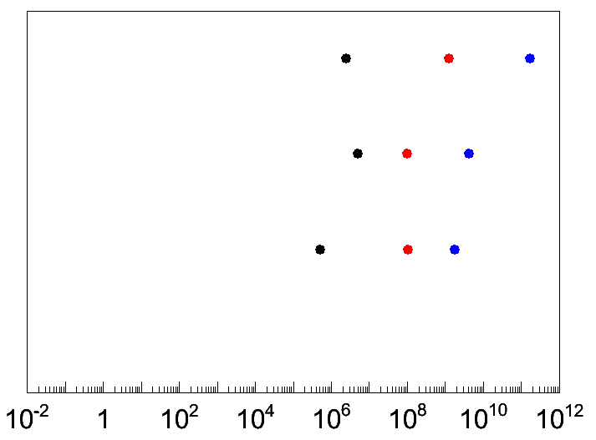
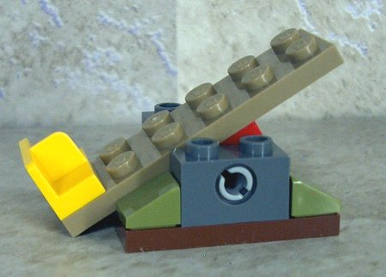
What’s else? known unknowns (4) Why so light?
u
c
t
up quark family
down quark family
d
s
b
Dirac Fermionn
mass via coupling to Higgs
charged lepton
e
μ
τ
neutrino
Seesaw mechanism
Minkowski,(’77), Yanagita(’79), GellMannn, Ramondo, Slansky(’79),Glashow(‘79)
$$\frac{m^{2}}{M}$$
observed mass is the one diagonalized
$$\left(\overline{ν_{L}},\overline{{\left(ν_{R}\right)}^{c}}\right)\left(\begin{matrix}0 & m \\ m & M\end{matrix}\right)\left(\begin{matrix}{\left(ν_{L}\right)}^{c} \\ ν_{R}\end{matrix}\right)$$
$$M$$
Dirac mass ~1MeV
Majorana mass
${10}^{12}$GeV ~GUT scale?
It is crucial to conclude if neutrino is Majorana or Dirac.

Slide 26
What’s else? known unknowns (5) Leptogenesis?
Matter in the present universe ← 10⁻⁹ difference in quark and anti-quark in early universe.
Which CPV produced this difference?
CKM CPV is too small ( 7 orders of magnitude)
Leptogenesis
CPV in the decay of Heavy right-handed neutrino
The mass required for the seesaw mechanism well match
Confirmations of $ν$ as Majorana-type and CPV in lepton sector are important
CPV in $ν$ oscillation could be either non-related or related, but important to demonstrate that nature allows CPV large enough to create the universe
$$\left|\sin{θ_{13}\sin{δ}}\right|≥0.09 → \left|\sin{δ}\right|≥0.58$$
PDG2015

Slide 27
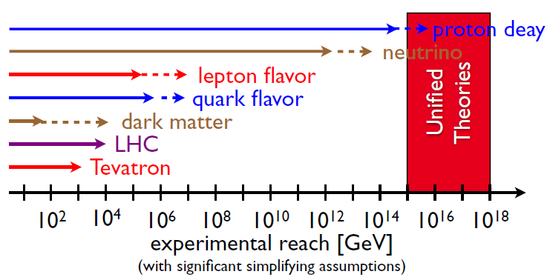
What’s else? unknown unknowns
$K\text{/}B\text{/}μ\text{/}τ/n$, and LHC : searching for <10TeV new physics. Sensitivity by $ν$ measurements is weak.
However, tiny mass could be due to physics in very high energy, hence such physics could appear at measurements sensitive to $m_{ν}$.
Now, we will enter the era where redundant measurements are possible → inconsistency means something beyond the standard 3-$ν$ framework
“Future Experimental Programs” H. Murayama Phys.Scripta T158 (2013) 014025

Slide 28
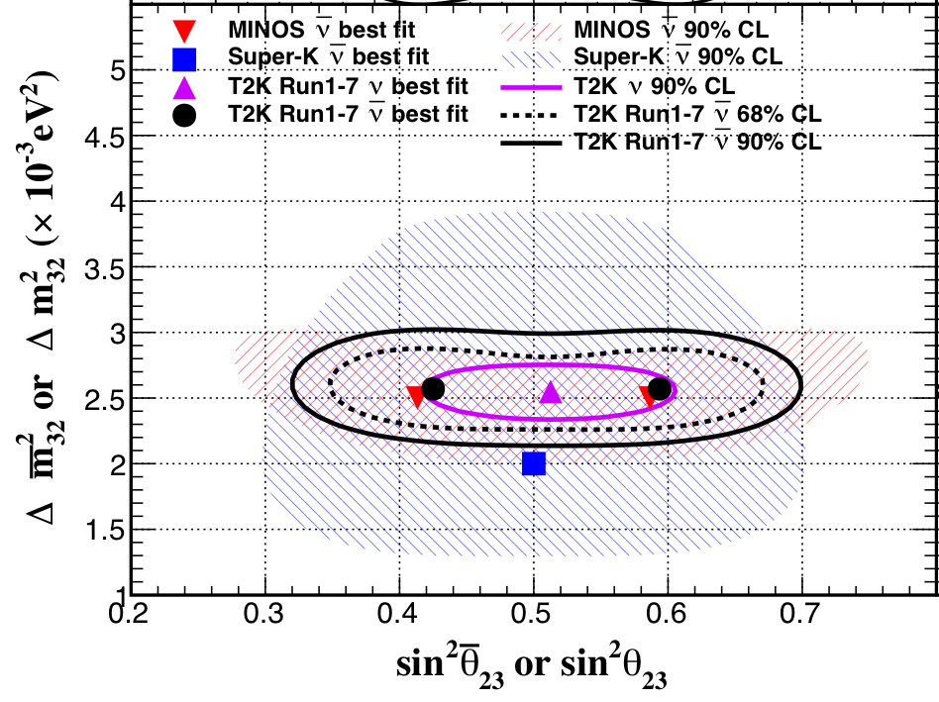
What’s else? unknown unknowns
Maximal allowed CP-asymetry in (anti-)$ν_{μ}→{(\text{anti}\text{−})ν}_{e}$ is 27%. If larger, new physics (e.g. sterile neutrino)
very short baseline reactor $ν$ deficit, LSND/MiniBooNE ${\overline{ν}}_{e}$ excess : sterile?
disappearance of $ν_{μ}$ vs ${\overline{ν}}_{μ}$. If different, CPT violation or non-standard $ν$-matter interaction
Precise comparison of $Δ{m^{2}}^{′}s.$ Solar vs reactor, reactor vs LBL’s at different $L$’s
Consistency among $ν$ oscillation, cosmology and $ν$-less double-beta decay
T2K $\overline{ν}$
T2K $ν$
reactor
(KamLAND)
solar

Slide 29
Summary
Flavor-mass mixing
Small in quark and large in lepton
CPV in neutrino oscillation is not yet observed, but can be large!
Accessible by on-going or next generation accelerator-based experiments.
This became clear after ~2012.
Indication of normal mass order?
to be determined by accelerator or reactor experiments.
Tiny mass indicates very high-energy physics
Majorana-type needs to be confirmed by $ν$-less double-$β$ decay
Leptogenesis: neutrino as an origin of matter-dominant universe.
What can we do? Let’s establish CPV and Majorana-type! then…?
Precise and redundant measurements are expected in coming years.
Another surprise?
Let’s hear talks!

Slide 30
In 10 years,
Oscillation $→Δm_{21}^{2},Δm_{32}^{2}$
CMB $→ m_{1}+m_{2}+m_{3}$
If neutrinoless double-beta decay is found, information on Majorana phase?
$$→ m_{1},m_{2},m_{3}$$
Inverted MH
Normal MH
double beta-decay
CMB

Slide 31
Approximated 3-flavor Oscillation at $∆m_{23}^{2}\frac{L}{4E}\sim \frac{π}{2}$
neglect Δm₁₂² term since $\frac{L}{E}$ is too small
ν_{e} disappearance : θ₁₃
short baseline reactor experiment
ν_{μ} disappearance : θ₂₃
long baseline accelerator experiment
ν_{e} appearance : θ₁₃

Slide 32
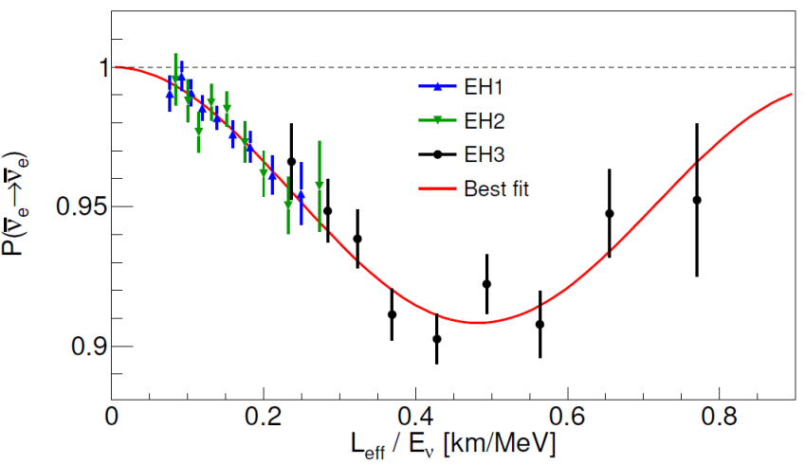
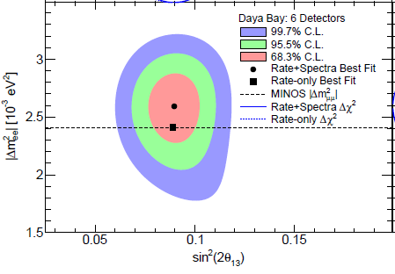
Daya Bay(Reactor Short Baseline) Latest result
sin²2θ₁₃=${0.090}_{−0.009}^{+0.008}$
$\left|∆m_{ee}^{2}\right|={2.59}_{−0.20}^{+0.19}×{10}^{−3}$eV²
Oct. 2013

Slide 33
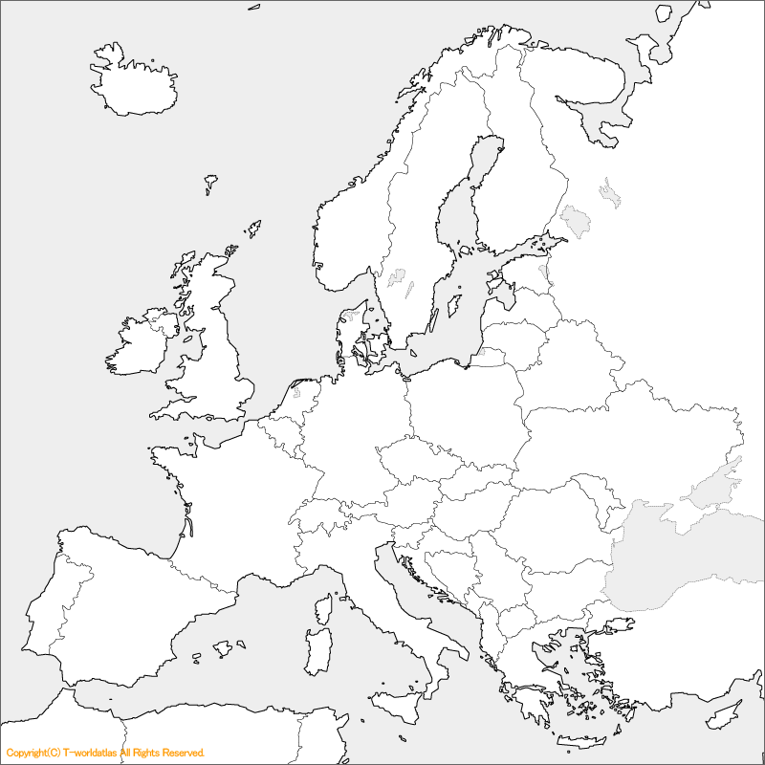
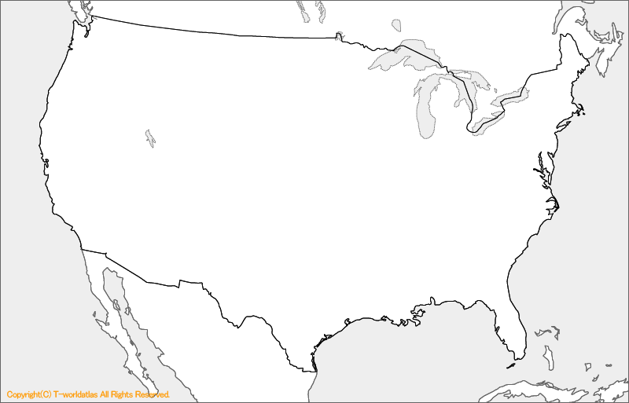
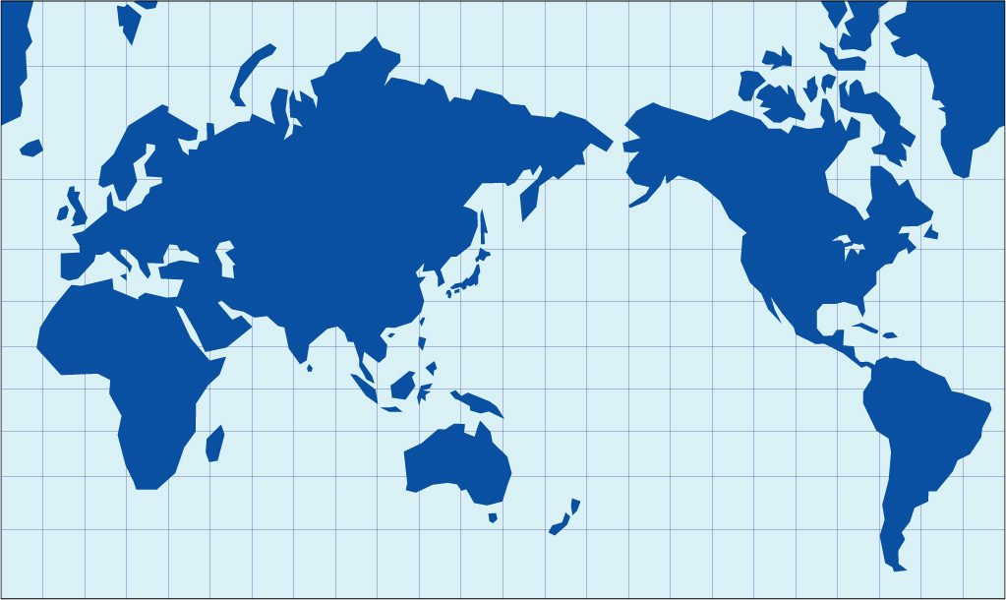
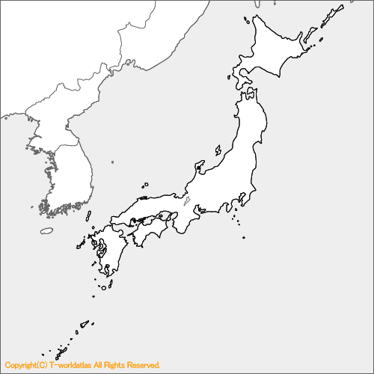
World LBL experiments
OPERA(2008-2012)
ICARUS (2010-2012) 732km
MINOS (2005- 2012) 735km
NOvA (2013-) 819km
K2K (1999-2004) 250km
T2K (2010-) 295km

