Slide 1
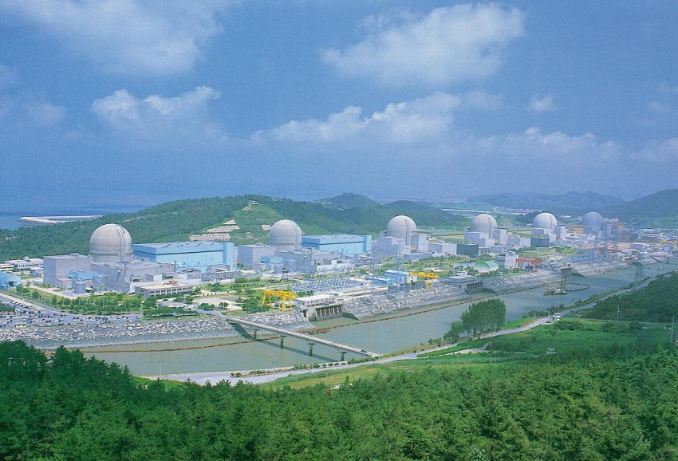

Recent Results from RENO
Jee-Seung Jang for the RENO Collaboration
GIST (Gwangju, Korea)
Flavour Physics Conference
ICISE, Quy Nhon 13th-19th Aug. 2017

Slide 2
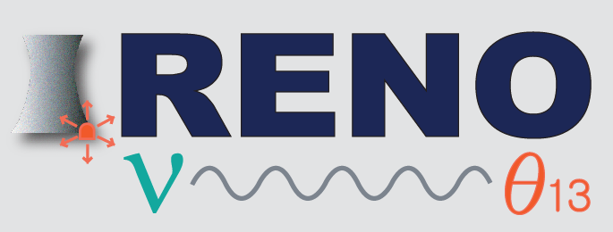
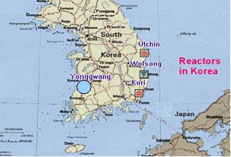
RENO Collaboration
Reactor Experiment for Neutrino Oscillation
(9 institutions and 40 physicists)
Chonnam National University
Dongshin University
GIST
Gyeongsang National University
Kyungpook National University
KAIST
Seoul National University
Seoyeong University
Sungkyunkwan University
Total cost : $10M
Start of project : 2006
The first experiment running with both near & far detectors from Aug. 2011

Slide 3
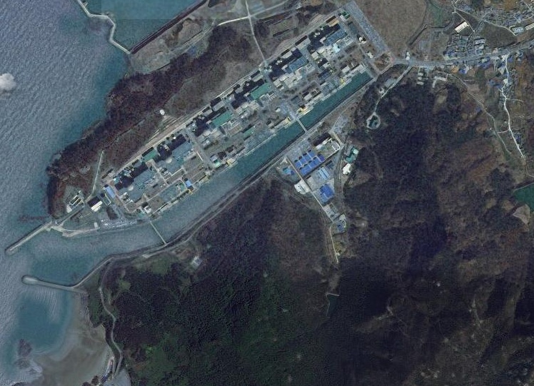

RENO Experimental Set-up
Near Detector
(120 m.w.e)
290m
- Hanbit Nuclear Power Plant
Maximum thermal output of 2.8 GWth
Linear array spanning 1.3 km
Reactor Antineutrino Disappearance
(sin²2θ_{13,} Δm_{ee}²)
1380m
Far Detector
(450 m.w.e)

Slide 4
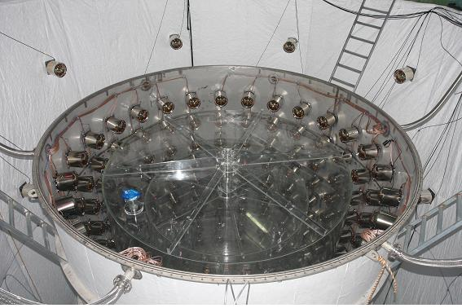

Neutrino Detection by RENO Detector
prompt signal
Target : 16.5 ton Gd-LS (R=1.4m, H=3.2m)
Gamma Catcher : 30 ton LS (R=2.0m, H=4.4m)
Buffer : 65 ton mineral oil (R=2.7m, H=5.8m)
Veto : 350 ton water (R=4.2m, H=8.8m)
354(Buffer) / 67(Veto) 10” PMTs
~28 μs (0.1% Gd)
delayed signal

Slide 5
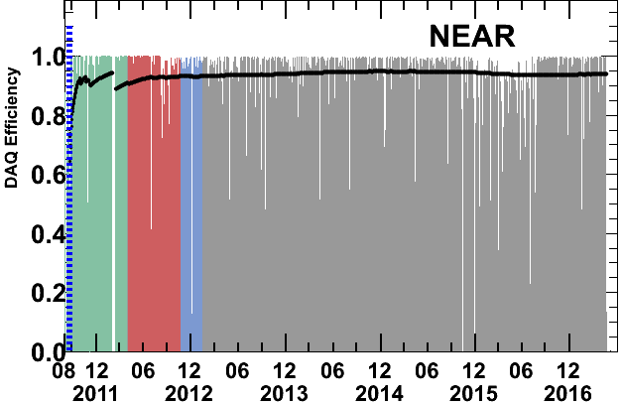
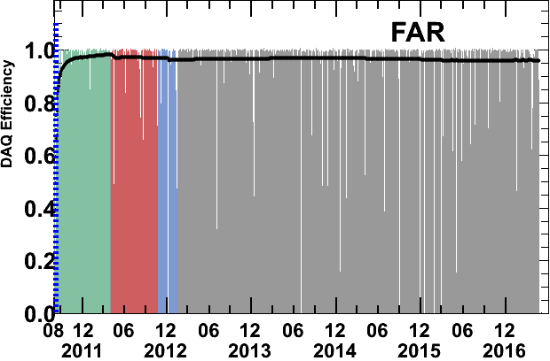
RENO Data-taking Status
Data taking began on Aug. 1, 2011 with both near and far detectors.
(DAQ efficiency : ~95%)
A
A (220 days) : First θ₁₃ result
[11 Aug, 2011~26 Mar, 2012]
PRL 108, 191802 (2012)
B
Now
B (403 days) : Improved θ₁₃ result
[11 Aug, 2011~13 Oct, 2012]
NuTel 2013, TAUP 2013, WIN 2013
C (500 days) : First |Δm_{ee}²| result
Rate+shape analysis (θ₁₃ and |Δm_{ee}²|)
[11 Aug, 2011 ~ 21 Jan,2013]
PRL 116, 211801 (2016)
submitted to PRD (arXiv:1610.04326)
C
D (1500 days)
D (1500 days) : New results
[11 Aug, 2011 ~ Sep, 2015]
Total 2000 days

Slide 6
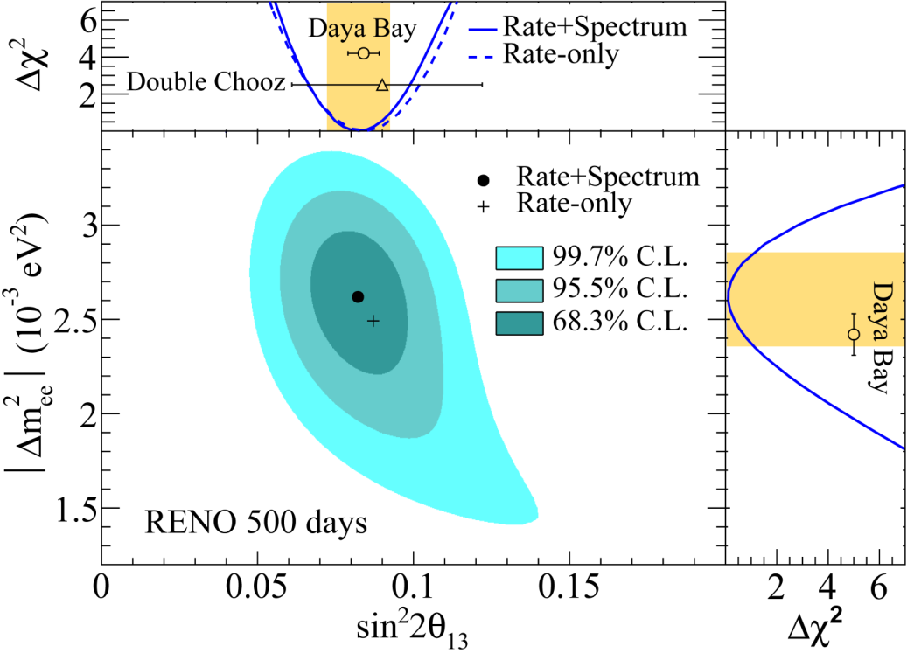
Last PRL Result in 2016
PRL 116, 211801 (2016)

Slide 7
New Results from RENO
  Updated result for Δm_{ee}² and θ₁₃ using 1500 live
  days of data
  Observation of an excess at ~5 MeV in reactor
  neutrino spectrum using 1500 days of data
  Measurement of absolute reactor neutrino flux using 1500 days

Slide 8
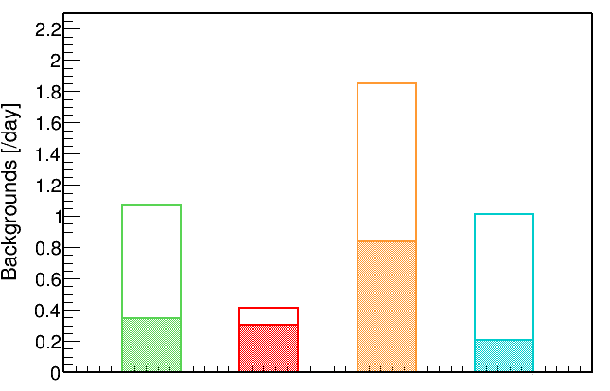
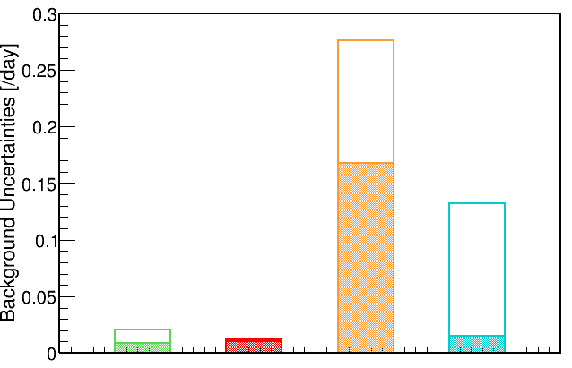




Reduction of background rates & uncertainties
Allows precise measurements of $\sin^{2}2θ_{13}$and $Δm_{ee}^{2}$
* Far : 2012 Oct. ~ 2015 Sep.
Accidental
Fast
Neutron
$${}_{}^{9}{Li/{}_{}^{8}{He}}$$
$${}_{}^{252}{Cf}$$
Accidental
Fast
Neutron
$${}_{}^{9}{Li/{}_{}^{8}{He}}$$
$${}_{}^{252}{Cf}$$
• Accidentals : Additional cuts and improved flashing-PMT removal algorithms
• Cosmogenic ${}_{}^{9}{Li/{}_{}^{8}{He}}$ : Optimized muon veto criteria
• ${}_{}^{252}{Cf}$ contamination : Improved multiple-neutron removal algorithms

Slide 9
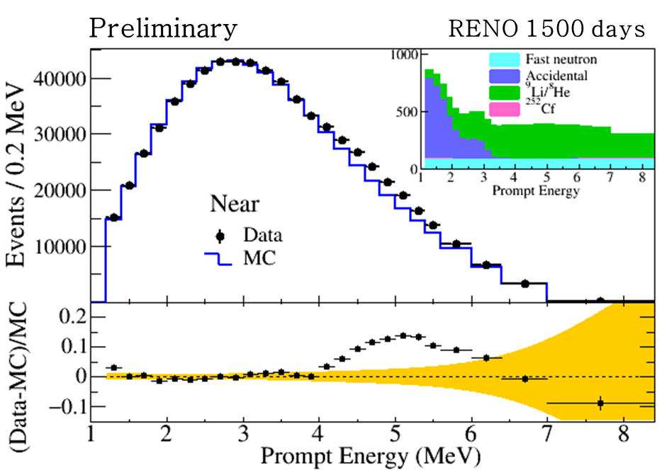
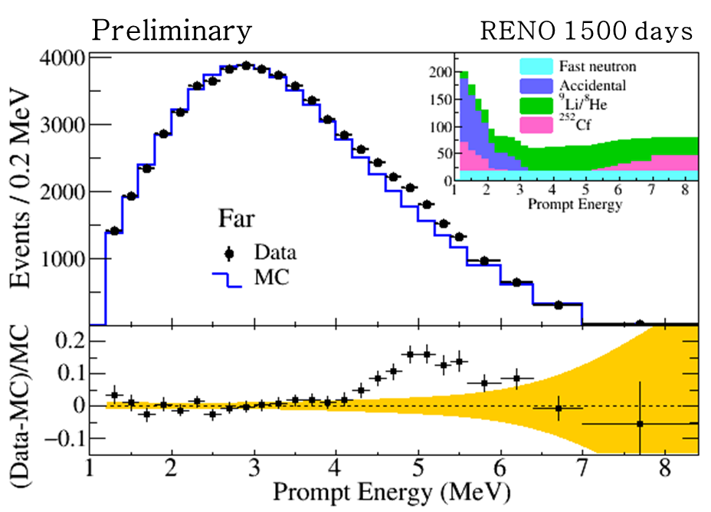
Measured Spectra of IBD Prompt Signal
RENO’s observation of 5 MeV excess
~2.5 %
Clear excess at 5 MeV
~2.5 %

Slide 10
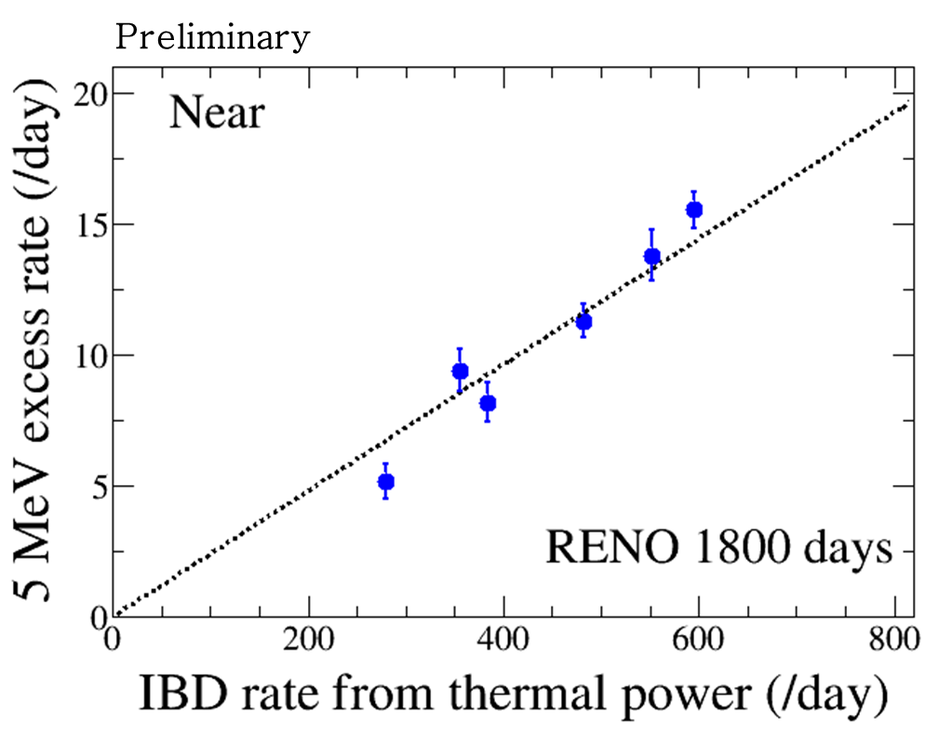
Correlation of 5 MeV Excess with Reactor Power
5 MeV excess
has a clear
correlation
with reactor
thermal power !
All the six reactors are on
two or three reactors are off
The 5 MeV excess comes from reactors!

Slide 11
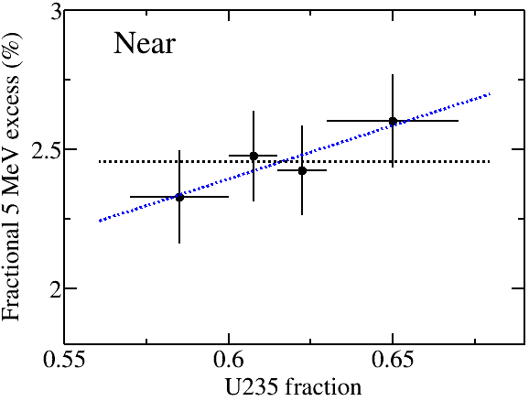
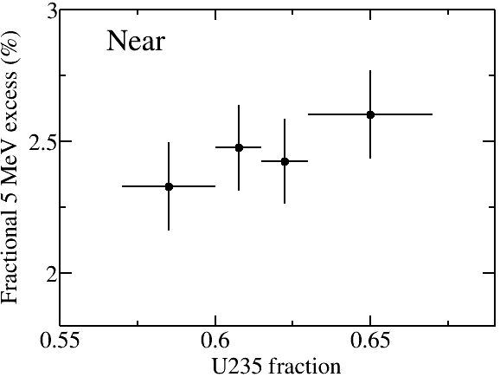
Correlation of 5 MeV excess with ²³⁵U isotope fraction
Preliminary
RENO 1500 days
Fit function | χ²
y = a | 1.407
y = a*x + b | 0.233
Δχ² = 1.174
P-value = 0.240
(End
of reactor cycle)
(Beginning
of reactor cycle)

Slide 12
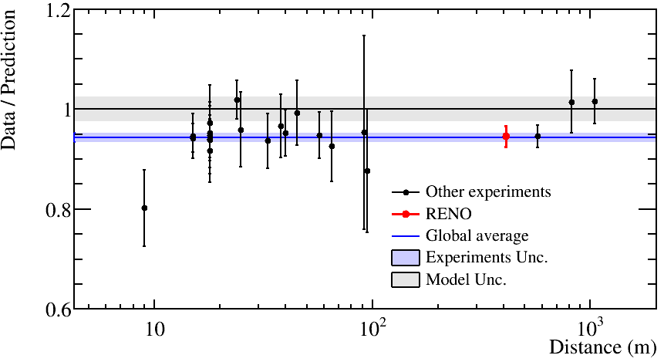
Measurement of Absolute Reactor Neutrino Flux
RENO 1500 days at near (411 m) | Data / Prediction (Huber + Mueller)
 | 0.946 +- 0.021
Preliminary
Short baseline measurement (<100 m)
Deficit of observed reactor neutrino fluxes relative to the prediction (Huber + Mueller model) indicates an overestimated flux or possible oscillation to sterile neutrinos

Slide 13
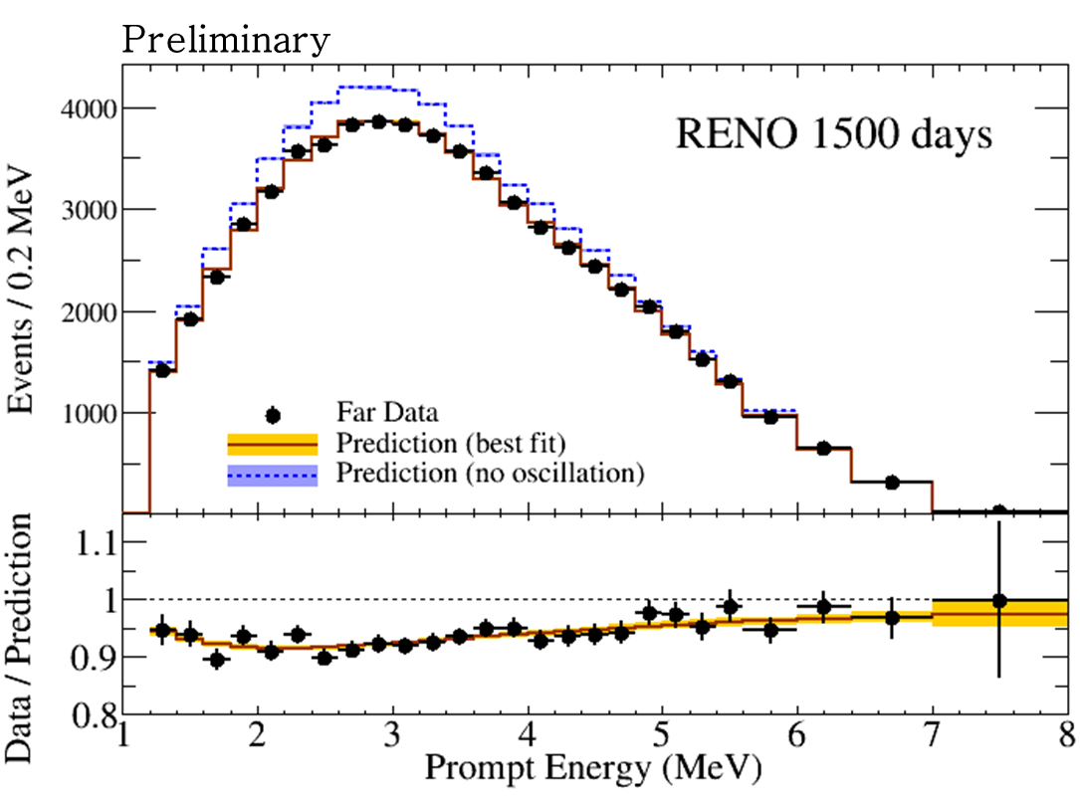
Results from Spectral Fit
Energy-dependent disappearance of reactor antineutrinos
(± 9 %)
(± 7 %)

Slide 14
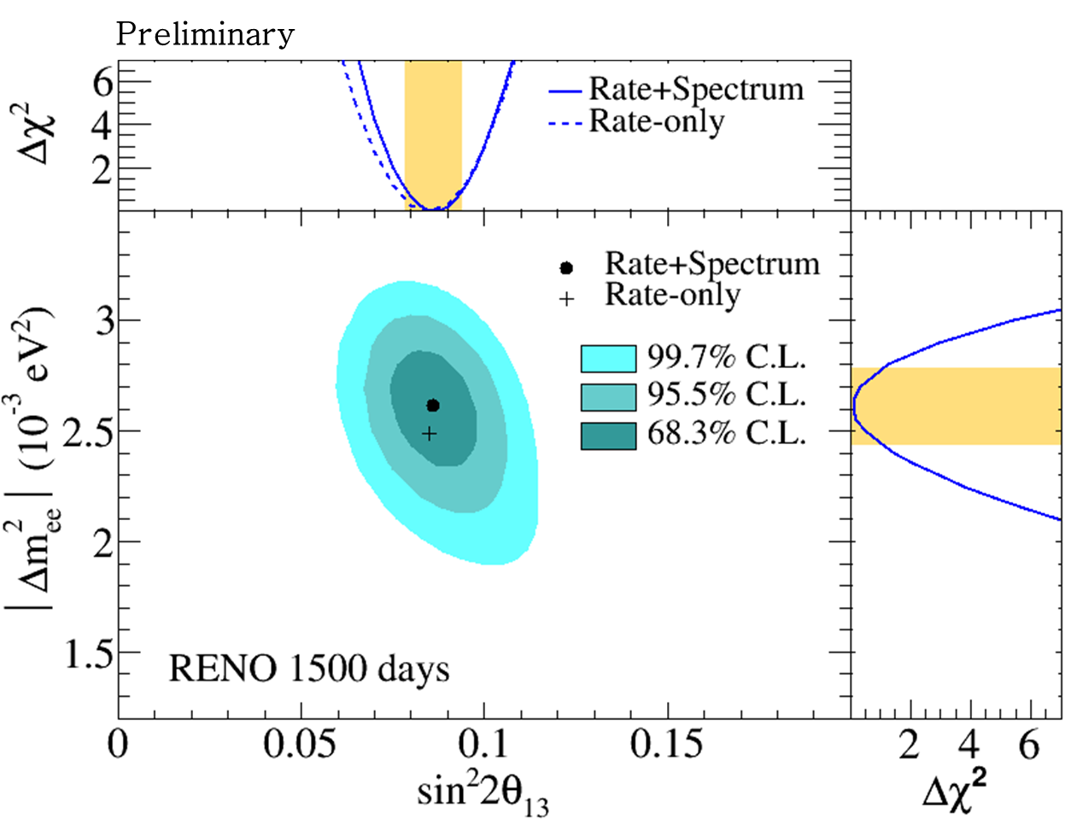
Allowed regions in |Δm_{ee}²| and sin²2θ₁₃

Slide 15
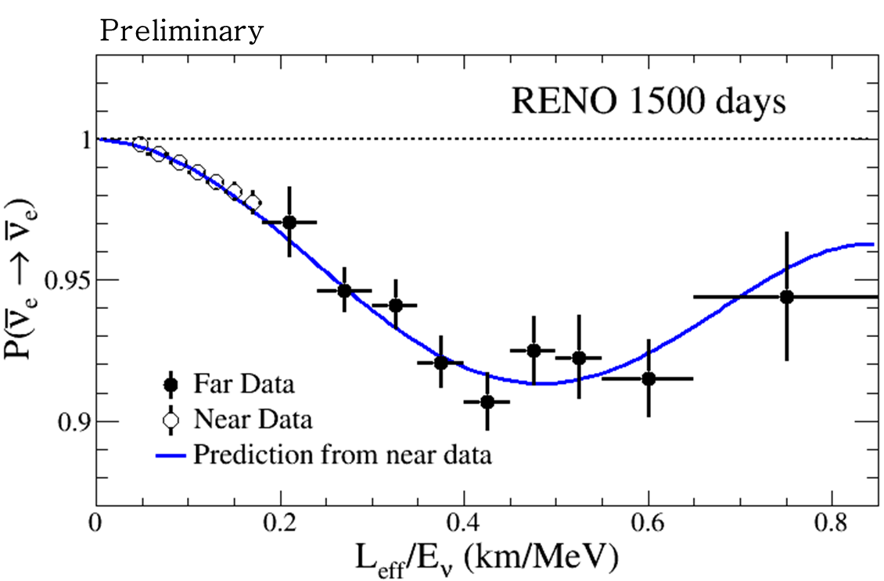
Observed L/E Dependent Oscillation

Slide 16
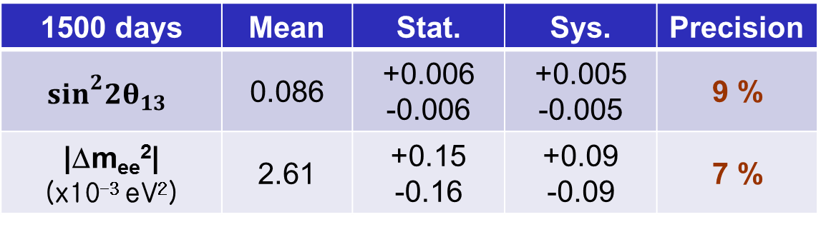
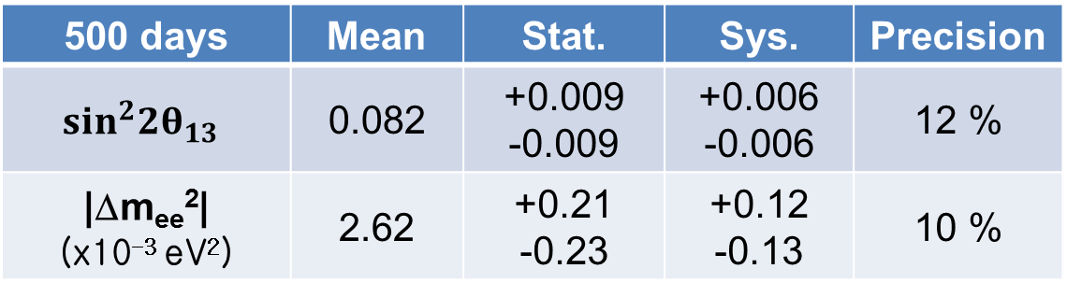
More precise measurement of θ₁₃ and |Δm_{ee}²|
PRL 116, 211801 (2016), Submitted to PRD (arXiv:1610.04326)
500 days | Mean | Stat. | Sys. | Precision
$$\sin^{2}2θ_{13}$$ | 0.082 | +0.009 -0.009 | +0.006 -0.006 | 12 %
|Δm_{ee}²| (x10⁻³ eV²) | 2.62 | +0.21 -0.23 | +0.12 -0.13 | 10 %
New results (preliminary)
1500 days | Mean | Stat. | Sys. | Precision
$$\sin^{2}2θ_{13}$$ | 0.086 | +0.006 -0.006 | +0.005 -0.005 | 9 %
|Δm_{ee}²| (x10⁻³ eV²) | 2.61 | +0.15 -0.16 | +0.09 -0.09 | 7 %
Systematic errors are reduced due to background reduction and larger statistics of control samples

Slide 17
RENO : Plan and Prospects
Plan for RENO data taking
2017 | 2018 | 2019 | 2020 | 2021
RENO data will be taken for 2 more years from now and it will take 3 additional years for the analysis.
Possible extension of additional 2~3 years
According to our recent study, the systematic error of |Δm_{ee}²| is smaller than the statistical error.
sin²2θ₁₃ and |Δm_{ee}²| will approach to ~6% precision (our design goal).
 | 500 days Measured | 1500 days Measured (preliminary) | ~3500 days Expected
sin²2θ₁₃ | 12 % | 9 % | 6 ~ 7 %
|Δm_{ee}²| | 10 % | 7 % | 4 ~ 5 %

Slide 18
Summary
More precise measurements of θ₁₃ and Δm_{ee}² energy dependent disappearance of reactor neutrinos
(Preliminary)
±0.008 (9 %)
±0.18 (7 %)
(Preliminary)
Measured absolute reactor neutrino flux : R= 0.946±0.021
Observed an excess at 5 MeV in reactor neutrino spectrum
sin²(2θ₁₃) and Δm_{ee}² to 6% accuracy after 2 more years data taking
Additional 2~3 years of data taking under consideration to improve Δm_{ee}² accuracy

Slide 19
Thank you for your attention !

Slide 20


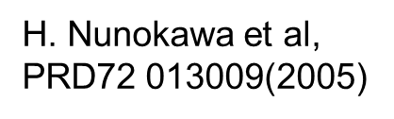

Reactor Neutrino Oscillations
ν_{e}
ν_{e}
Oscillations observed as a deficit of anti-neutrinos
ν_{e}
ν_{e}
ν_{e}
the position of the minimum is defined by Δm²_{ee}
ν_{e}
1.0
Probability ν_{e}
sin²2θ₁₃
flux before oscillation observed here
Distance
1200 to 1800 meters
$$\cos^{2}θ_{12}\left|Δ{m\text{2}}_{21}^{}\right|$$

Slide 21
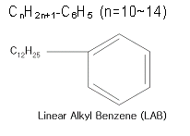
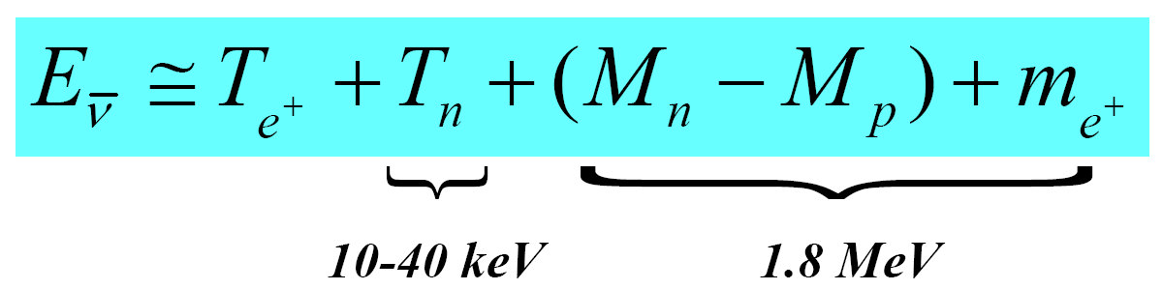
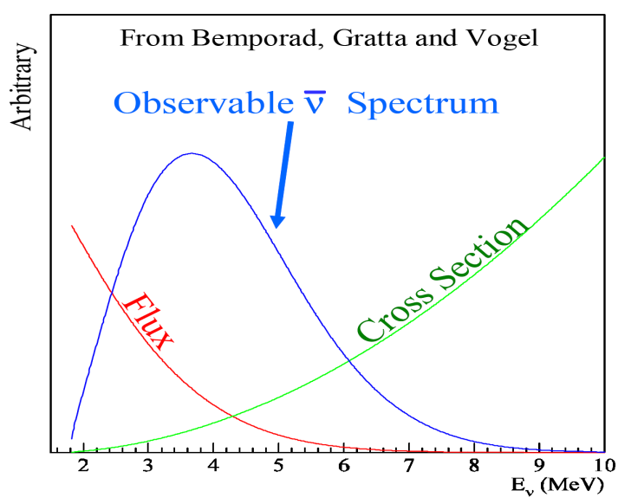
Detection of Reactor Antineutrinos
(prompt signal)
~180 μs
(delayed signal)
+ p → D + γ (2.2 MeV)
~28 μs
(0.1% Gd)
+ Gd → Gd + γ‘s (8 MeV)
Neutrino energy measurement

Slide 22
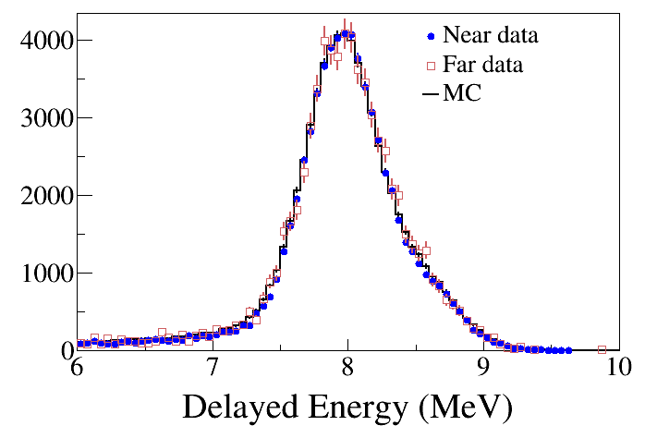
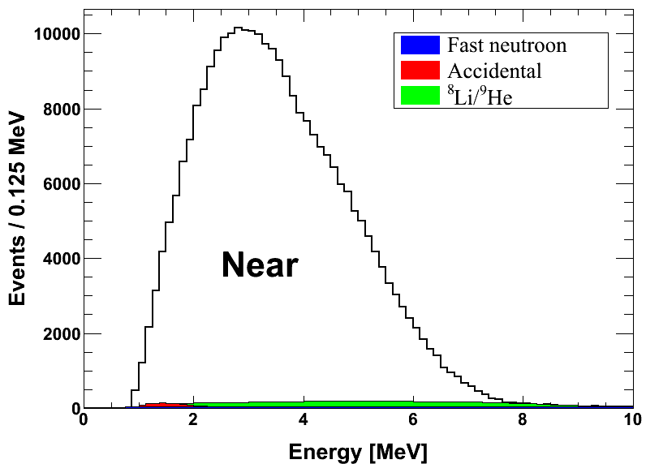
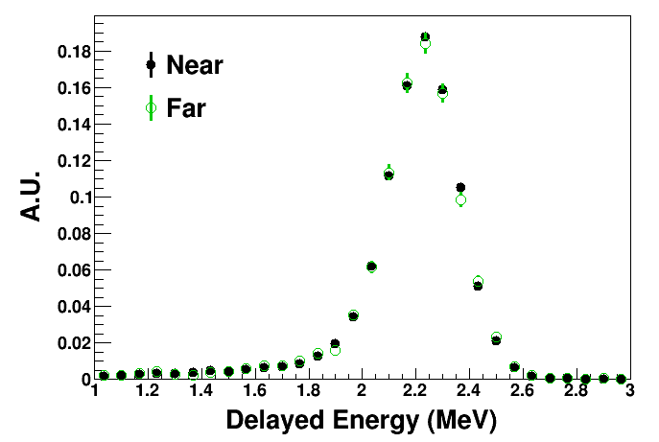
Coincidence of prompt and delayed signals
(prompt signal)
(delayed signal)
Delayed signal
Prompt signal
n-Gd IBD
~30 μs
8 MeV
~200 μs
n-H IBD
2.2 MeV

Slide 23
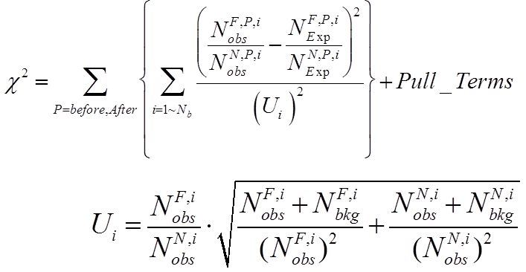
Far/Near Shape Analysis for |Δm_{ee}²|
Fit using far-to-near ratio
Observed
Far/Near
Expected
Far/Near
χ² fitter
Minimize Χ² Function
Energy-dependent disappearance of reactor antineutrionos

Slide 24
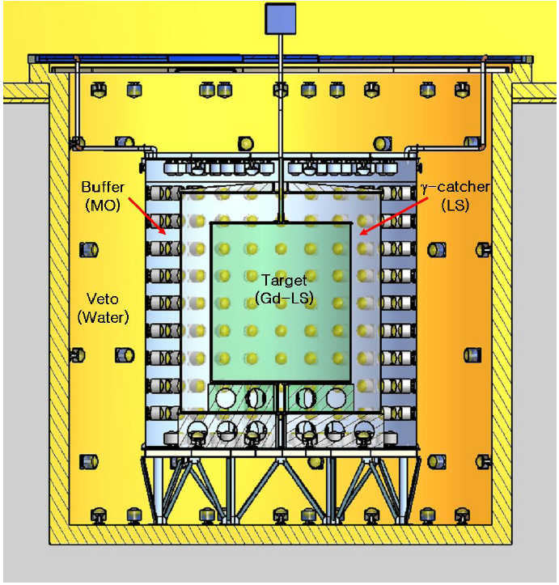
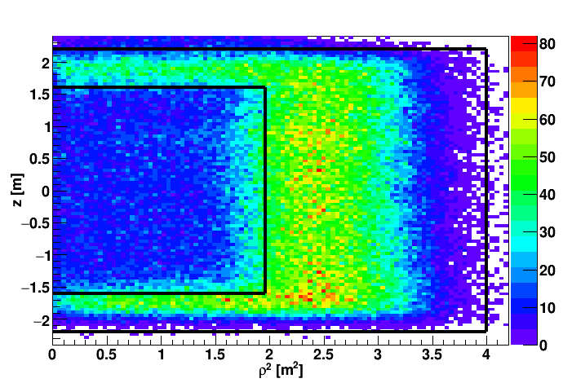
n-H IBD Analysis
1. Independent measurement of θ₁₃ value.
2. Consistency and systematic check on reactor neutrinos.
n-H IBD Event Vertex Distribution
target
γ-catcher
(Work in progress)
400 days of data before ²⁵²Cf contamination

Slide 25
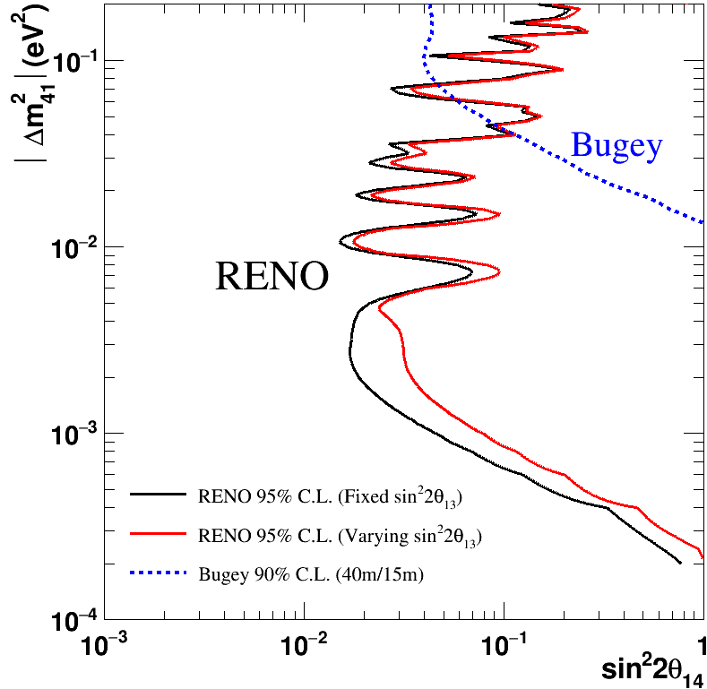
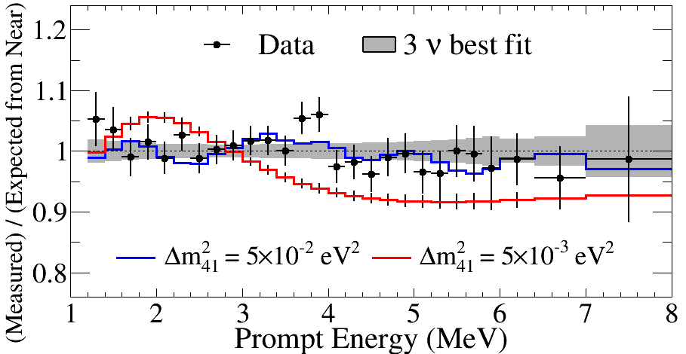
Light Sterile Neutrino Search Results
All 500 days of RENO data
Consistent with standard 3-flavor
neutrino oscillation model
Able to set stringent limits in
the region 10⁻³ < Δm_{ee}² < 0.1 eV²
(Preliminary)
full curves assumes sin²2θ₁₄ = 0.1

Slide 26
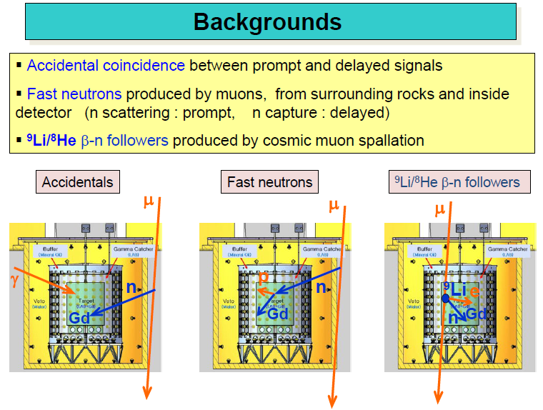

Slide 27
Observed Daily Averaged IBD Rate
preliminary
Good agreement with observed rate and prediction.
Accurate measurement of thermal power by reactor neutrinos

