Slide 1
Neutrino physics
Not really a summary;
really just some thoughts

Slide 2
What we know and what we don’t

Slide 5
Ichikawa

Slide 6
What we need to know:
Do neutrino oscillations violate the CP symmetry?
Ordering of neutrino mass eigenstates and neutrino mass scale
Empirical relationships between ν-mixing parameters ...
or between ν- and q-mixing parameters
Dirac or Majorana?
Anomalies (aka hints for sterile neutrinos):
statistical fluctuations, systematic effects or indications of new physics?
Impact: particle physics, astroparticle physics, cosmology, ...

Slide 7
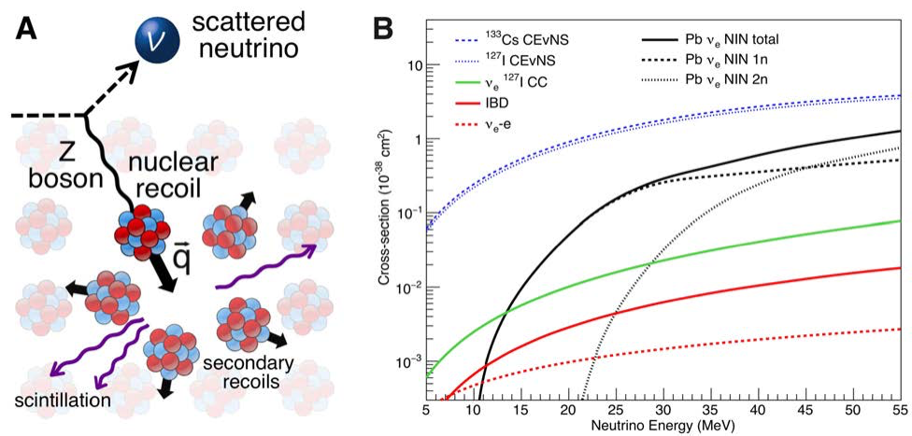
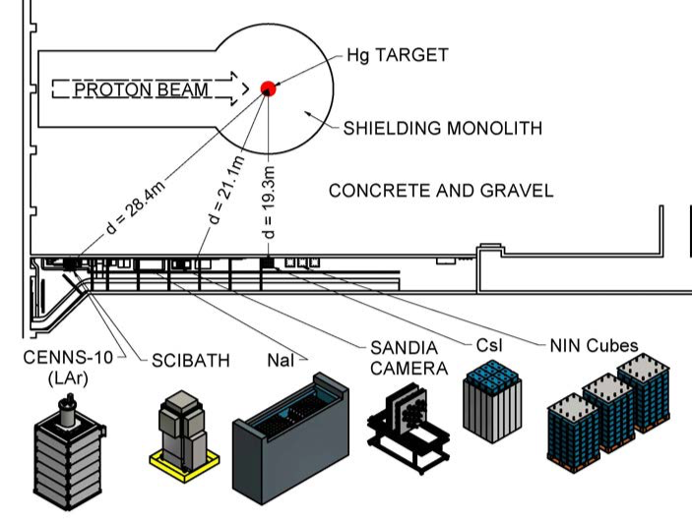
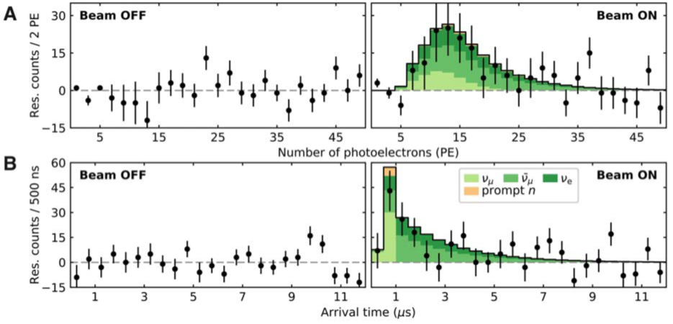
COHERENT
1708.01294 1708.01294
14.6-kg CsI[Na] scintillator
Neutrinos from SNS
Signal from pot cf before pot
Consistent (1σ) with SM CEνNS

Slide 8
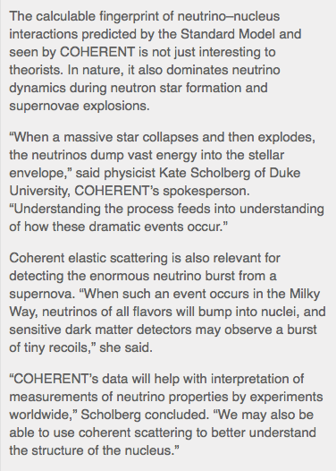
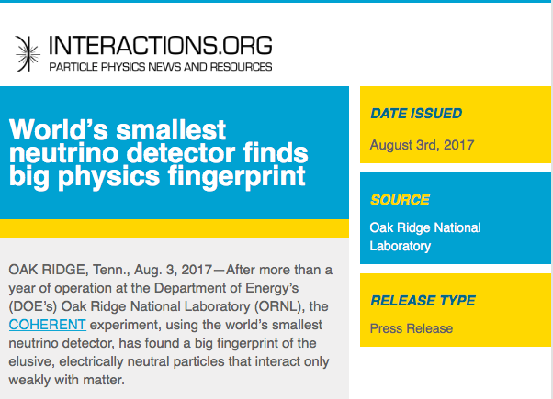

Slide 9
Working to find out

Slide 10
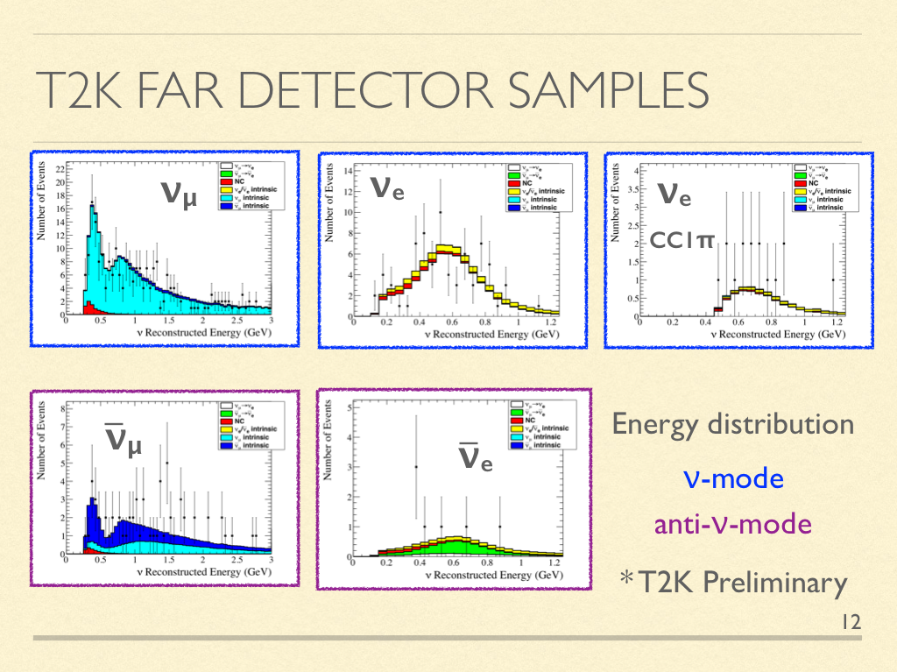
Do neutrino oscillations violate the CP symmetry?
New data:
  100+ ν_{e}s
Izmaylov

Slide 11
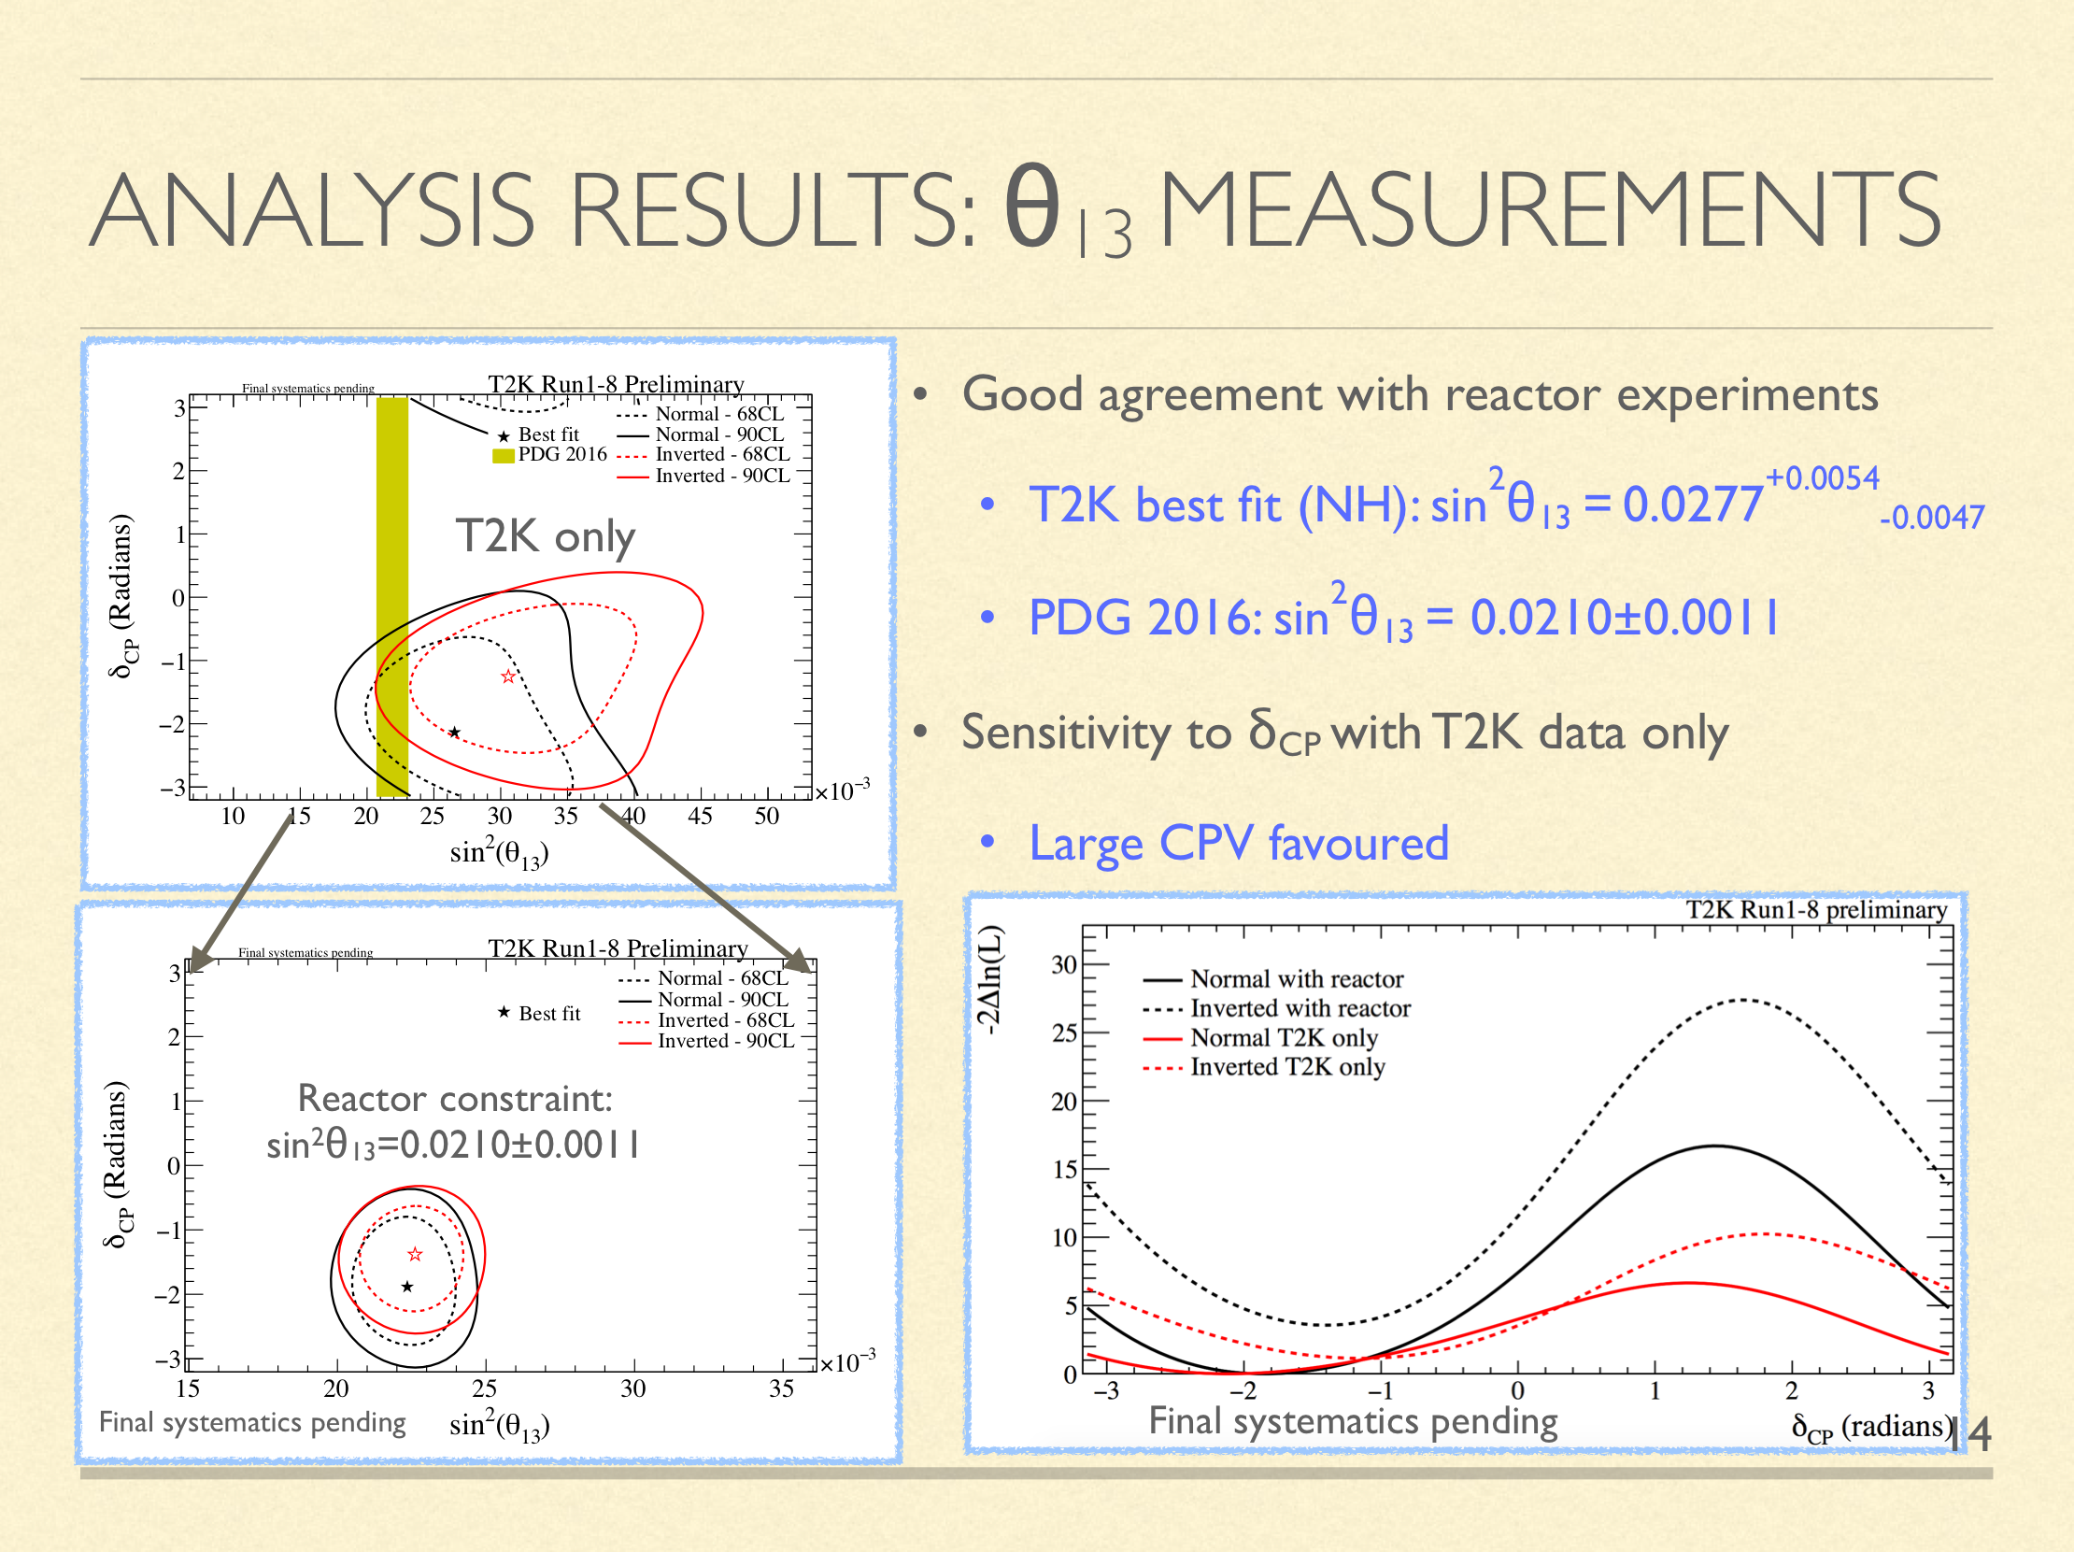
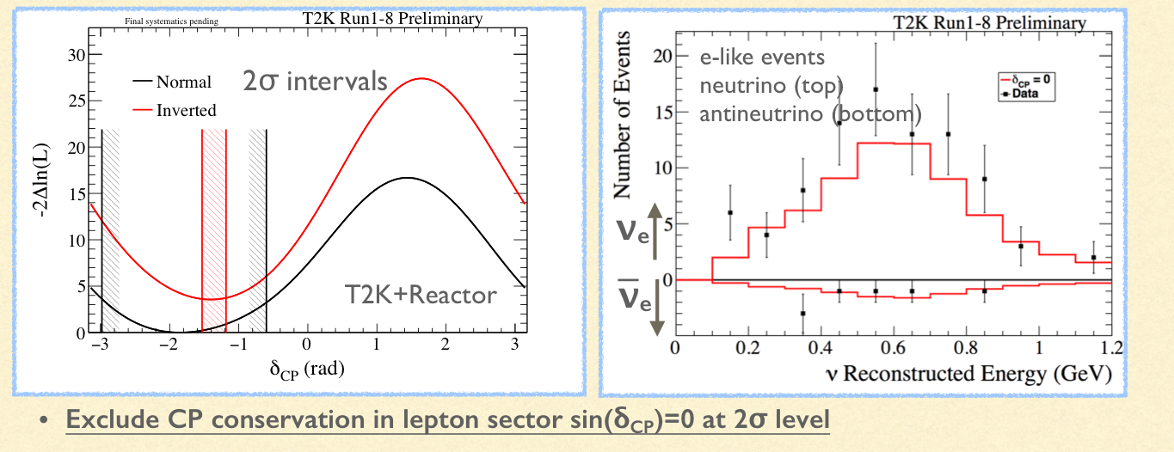
Do neutrino oscillations violate the CP symmetry?
Maximal CPiV favoured
2σ w/ reactor
Time will tell!
Izmaylov

Slide 12
Anomalies (aka hints for sterile neutrinos)

Slide 13
Anomalies (aka hints for sterile neutrinos)
Technical tour de force …
Automatic reconstruction demonstrated
Now poised to deliver physics programme
Full power for sterile neutino search comes with addition of SBND and ICARUS

Slide 14
Anomalies (aka hints for sterile neutrinos)
5 MeV excess also observed by Daya Bay and Double Chooz
Generated by reactor
(Likely) reduces significance of reactor-neutrino “hint” for sterile neutrinos
Near
Far
Jang

Slide 15
Anomalies (aka hints for sterile neutrinos)
Extrapolation of oscillation from near to far:
  Describes data in far detector very well
Could you see mixing into sterile at the level necessary to explain reactor anomaly?
Jang

Slide 16
Ordering of neutrino mass eigenstates
Ichikawa

Slide 17
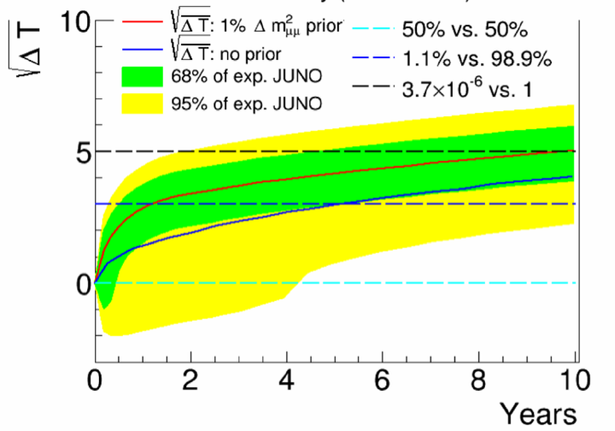
Ordering of neutrino mass eigenstates
Zhan
Good progress on construction
Ambitious energy-resolution specification
4.5σ—5σ sensitivity in
5—6 years

Slide 18
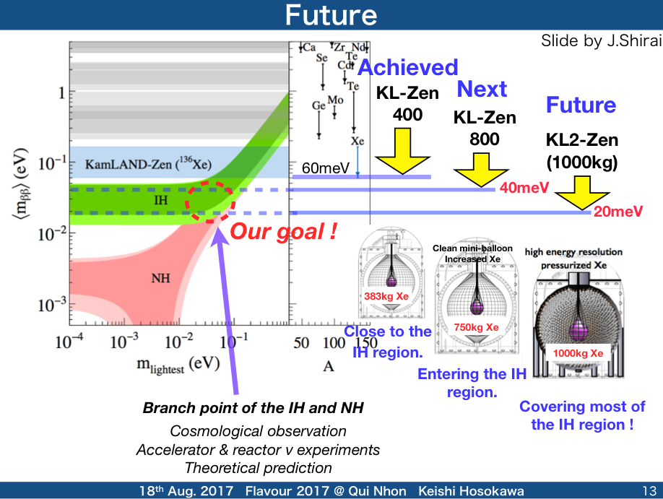
Dirac or Majorana?
Building on KL-Zen:
  800 kg Xe;
  Exciting sensitivity
Beyond:
  10+ years to KL2-Zen:
    1000 kg
    Pressurised Xe

Slide 19
Taking stock
CPiV:
  T2K/NOvA, T2K-II, HK/DUNE
Mass ordering:
  SK, NOvA, JUNO, HKK/DUNE, ORCA, PINGU
Empirical relationships?
  Requires sensitivity and precision
Dirac or Majorana:
  KamLand-ZEN, …
Anomalies:
  SBND, reactor-neutrino experiments, long-baseline neutrino experiments
Pursuing understanding requires:
  Novel, high-resolution detectors
  Novel beams with known flux and energy spectrum

Slide 20
The capability to obtain enlightenment

Slide 21
Novel detector techiques
Technique critical for DUNE;
  cm3 resolution in cathedral-sized volume
Muon reconstruction demonstrated:
  Efficiency looks good:
    Interesting to disentangle single-track from Pid efficiency
  Systematic uncertainty?
Elecron reconstruction efficiency:
  Important!
  In isolation and in the neighbourhood of hadrons

Slide 22
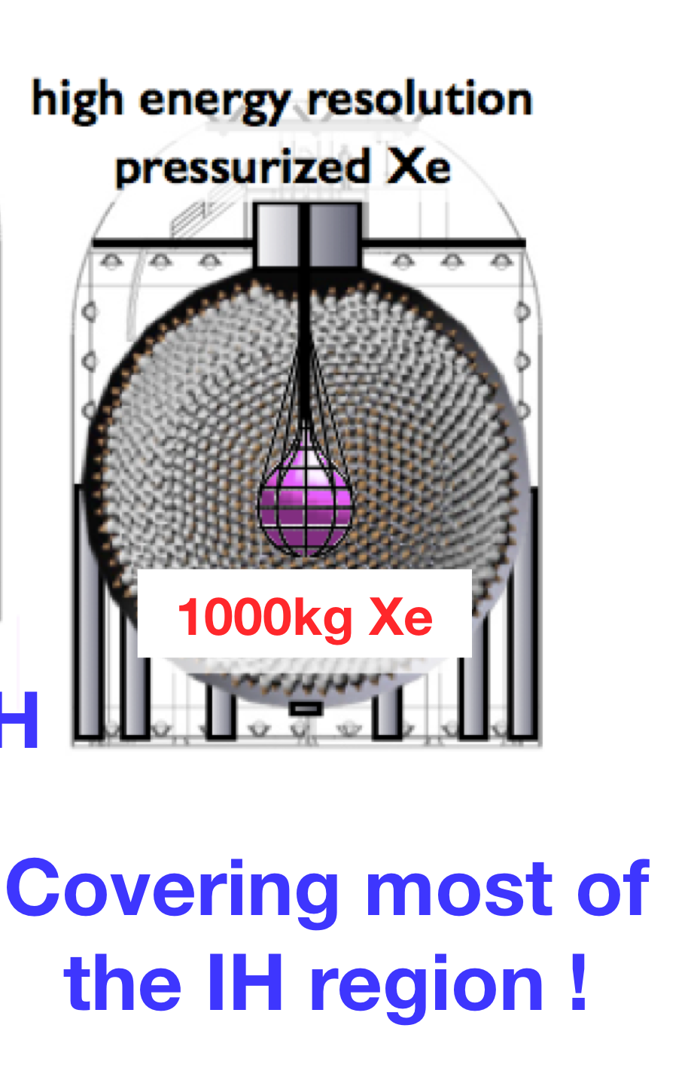
Novel detector techiques
Detailed programme to establish required energy resolution:
  Q.E. and transparency …
Can techniques be “ported” to KL2-Zen?

Slide 24
See e.g. Neutrino 2016
Abstract 20149
See e.g. Neutrino 2016
Abstract 20582
All can be constructed with today’s technologies.
nuSTORM

Slide 25
Finding the right balance:
  Between “sub-fields”
  Between headline measurements and R&D
New capabilities will, most likely, be required

Slide 26
ICFA Neutrino Panel Roadmap
Need to develop the “Panel concept” to broaden its scope

Slide 27
And finally …

Slide 28
And finally …
Clearly a vibrant and diverse field that:
  Will complete the “Standard Neutrino Model”;
  Is interconnected:
    Has impact on astroparticle physics and cosmology;
    Is impacted by astroparticle physics and cosmology;
    Has synergy with fixed-target/beam dump and collider
Enlightenment? The physics of flavour:
  It seems likely that new techniques … experiment, accelerator and theory … will be required to understand the Standard Neutrino Model:
    “Internal relationships”; neutrino-quark relationships
  W/s such as this are an important to create the conditions for the required insights to be articulated

